Slide 1
Çré Båhad Bhägavatämåta of Çréla Sanätana Gosvämé
The story of Gopa-kumära

Slide 2
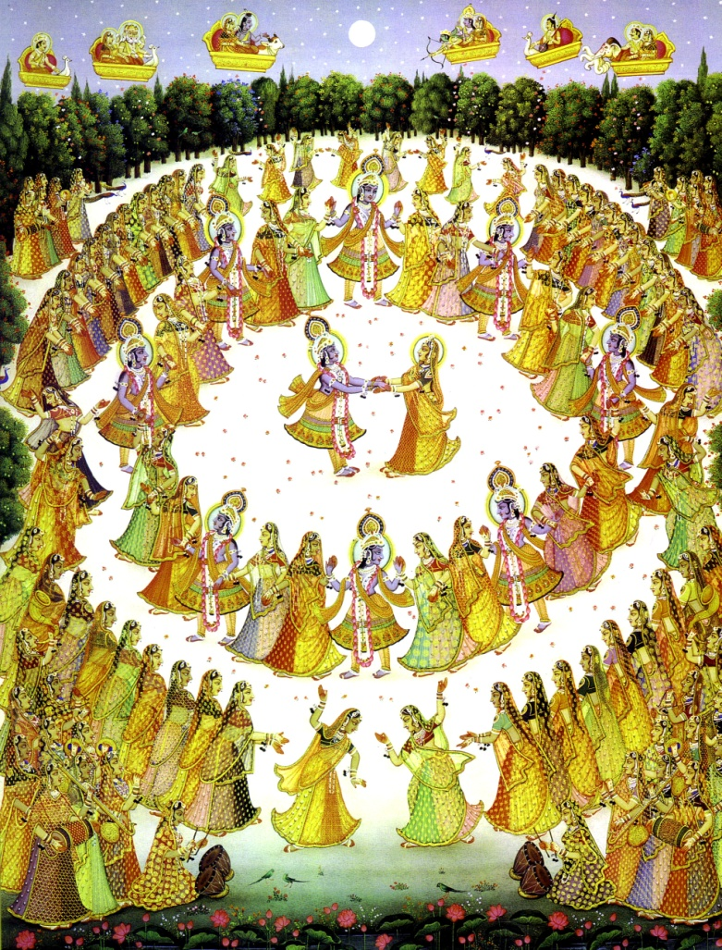
Uttarä inquires from Parékñit
Notes:
Uttara describes Vaikuntha and inherent equality of all residents. She asks: What is destination of the devotees of the Performer of the Rasa dance? Uttara is concerned that the devotees of Gokula are situated higher; “Please tell me about the place higher than Vaikuntha”

Slide 4
The story of a poor brähmaëa who hankered after abundant wealth
Notes:
Once there was a poor brahmana living in Pragyotisa-he wanted wealth-was ignorant; He worshipped goddess Kamakhya

Slide 5
kléà
Notes:
Kamakhya gave the brahmana the Gopal Mantra to worship Madhana Gopal. He chanted, gave up desire for wealth and became satisfied

Slide 6
ten-syllable gopäla-mantra
The mantra manifested itself before him like a valuable treasure-chest had opened right before his eyes.

Slide 7
Gaìgä
Notes:
The brahmana traveled to Ganga Sagara (ocean-Ganges) during the festival month Margh, saw brahmanas; They told him about duties the fruit of which is attainment of heaven
He followed them but continued chanting his mantra so was not satisfied

Slide 8
Käçé, where he saw sannyäsés propounding monism
Notes:
the brahmana became dissatisfied with rituals and went to Kasi (Advaita sannyasis); Sanyassis talk about liberation-he became attracted and wanted to be a sannyasi
His faith in mantra was damaged by association with impersonalists

Slide 9
Foolish man, don’t take sannyäsa! Go at once to Çré Mathurä. There in the Våndävana forest you will surely fulfill all your desires.”
Notes:
In his dream the Deity of Mantra (Madan Gopala) appeared and he became more attached to the mantra again; In a dream he saw Siva chastising him, told him not to take sannyasa and to go to Mathura

Slide 10
Prayäga
Notes:
The brahmana stopped at Prayag on the way-festival worshipping Visnu-He thought festival was noise; Asked Vaisnavas what they were doing. They chastised him and explained
He asked them: Where does God live, his qualities, what are the benefits of chanting?
They answered: He lives everywhere, supersoul, Vaikuntha, you should bow and worship him
He noticed similarity between the Deity of his mantra and Madhava there but didn’t realize they were same—he thought all Visnu forms were not the same as Krsna

Slide 11
Notes:
He noticed similarity between the Deity of his mantra and Madhava there but didn’t realize they were same. Madhava in Prayag had 4 arms, Madana Gopal 2, Others in Prayag: Nrsimha, Rama, Vamana, Kurma. The brahmana did not recognize they were the same person, thinking, “My Lord is a cowherd boy and enjoys with the cowherd girls”
He was attached to Madana Gopal, fainted and continued chanting. Madhava appeared to him in a dream and told him to go to Vrindavan immediately

Slide 12
Meeting Gopa-kumära in Våndävana
Notes:
In Vrindavan the brahmana was enlivened. He heard someone crying in Kesi Ghat who was executing sankirtana in pure love of Godhead; He was cowherd boy and brahmana thought he was Gopal. That cowherd made him sit down and knew who he was; the brahmana asks for spiritual guidance. Cowherd wants him to chant the names in sankirtana but to convince him tells him his history. Cowherd’s name is Gopa Kumar.

Slide 13
Gopa-kumära’s Story

Slide 14
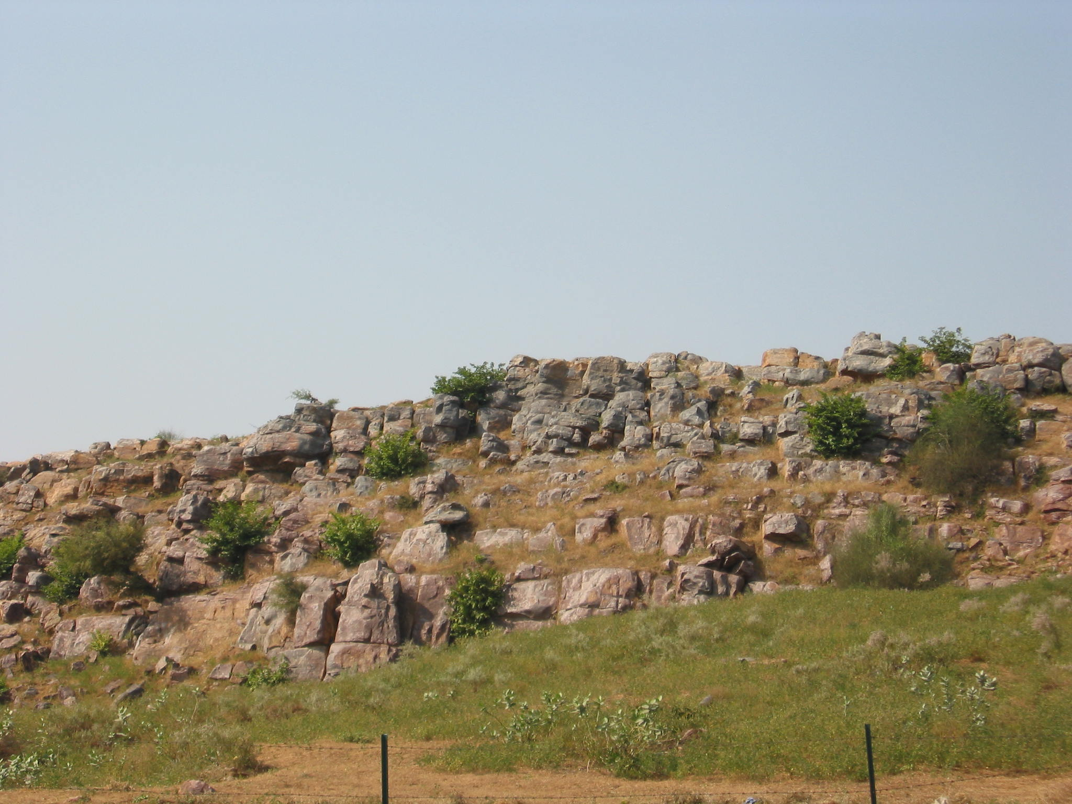
Notes:
Gopa Kumar was the son of Vaisya of Govardhana, used to tend cows. “We cowherd boys used to see a first class brahmana, renounced, wandering, chanting, dancing, laughing
Bowed to cowherds, kissed them, stayed in their company, cowherds gave him milk products

Slide 15
Notes:
“We cowherd boys used to see a first class brahmana, renounced, wandering, chanting, dancing, laughing
Bowed to cowherds, kissed them, stayed in their company, cowherds gave him milk products

Slide 16
Notes:
Brahmana instructed GK to fulfill all his desires he should bathe in Kesi ghat and accept special mercy. He gave Gopal Mantra to Gopa Kumar and started to explain mantra-then overwhelmed with tears and was unable. Went away-Gopa Kumar did not understand this but continued to chant

Slide 17
Notes:
Gopa Kumara was determined to understand the Lord of the universe while chanting his mantra.

Slide 18
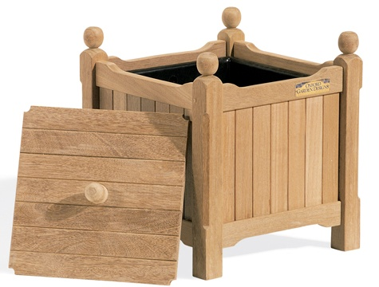
Notes:
GANGA
Went to Ganga- saw Brahmana worshipping Sila and asked ,”What are you worshipping?” Brahmana said: “Lord of the Universe.” Gopa Kumara became joyful, bowed, got caranamrta and prasad. Then the brahmana put Sila in box, Gopa Kumara was upset: how will He eat, etc. Brahmana consoled: if you want to see opulent worship go to capital; GK immediately left for capital

Slide 19
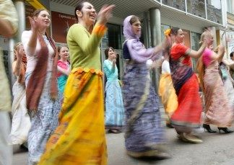
at the capital
Notes:
CAPITAL
Deity-opulent worship-4 arms dancing all the devotees; Gopa Kumara stayed there but never forgot the beauty of Vraja.

Slide 20
Notes:
CAPITAL
King adopted GK-King died-GK became king. Brahmanas there too ritualistic, administrative problems, didn’t respect prasadam properly.
Saints arrived from Puri-described Puri. People in Puri not attached to rituals, respect prasad, even donkeys have 4 arms, everyone liberated

Slide 21
Notes:
went to Jagannatha Puri

Slide 22
Notes:
Went to Puri-ecstacy-Ran to embrace Jagannatha, Guards beat him; Wanted to do intimate service for the Lord

Slide 23
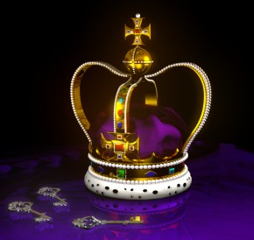
again, he meets his guru and then becomes king
Notes:
Saw Guru but he disappeared, Found him on beach-guru embraced GK; Guru explained that whatever you desire while chanting that desire fulfilled (Sankalpa). Have faith in the mantra and never give it up. By Mantra’s potency you will live long, always look the same, and develop correct mentality. Guru disappeared.
Gopa Kumara continued chanting and seeing Lord Jagannatha. King of Puri died-son renounced, ministers appointed GK as king. Gopa Kumara improved worship-but disturbed by royalty-renounced kingdom but people still honored him. Went to Jagannatha to get permission to go to Vrindavan, but when he saw Jagannath he forgot request

Slide 24
“Just go to Mathurä”
Notes:
Residents of Mathura visited-GK had a dream-Jagannatha said Mathura more dear, Lord Jag said: “Go to Vrindavana”-then got garland from the Deity corroborating order of Lord Jagannatha

Slide 25
Notes:
Mathura
Wandered in Vrindavan unnoticed by old friends, but was dissatisfied because he could not see “Lord of the Universe” in Vrindavan; He was not yet purified in vision so could not see Krishna there

Slide 26
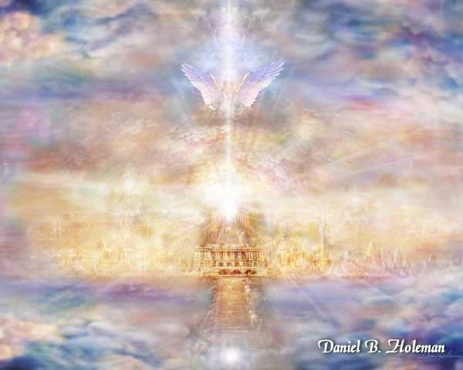
Notes:
Set off for Puri again but on the way saw Brahmanas at the Ganga; Brahmans talk about Svarga and also subterranean heaven: In heaven Lord is present as Vaman
GK chanted his mantra-airplane came-went to heaven

Slide 27
Offering the special gifts of heaven like amåta and the pärijäta flower, Indra worshiped Lord Vämana
Notes:
SVARGA
Saw Visnu, Garuda, Narada etc in heaven; Visnu called out to him-come here-GK wanted to worship Him like Indra did

Slide 28
Gopa-kumära becomes Indra
Notes:
Indra violated chastity of Sage’s wife-hid himself-GK appointed as Indra. He continued chanting, lived simply, never forgot Vrindavana (feeling separation) lived simply.
Visnu placated GK when he was feeling separation; Sometimes Visnu disappeared-GK felt more sep-wanted to see Jagannatha.

Slide 29
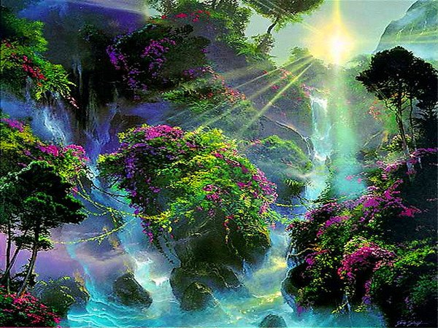
Bhågu from Maharloka
Notes:
Brighu and sages came one day-demigods and Visnu worshipped them; GK asked demigods who they were-demigods didn’t reply (envious) so Brhaspati answered: “They are from Mahar-loka (prajapatis) and they worship the Lord of Sacrifices”-GK wanted to go there

Slide 30
Maharloka
Notes:
Maharloka
Lord of Sacrifices enjoying offerings in the fire; Lord gave GK His remnants, sages offered GK brahmana status but GK refused wanted to remain Vaisnava servant. Lord disappeared between sacrifices-GK great pain during Brahma’s night-no sacrifices and no Lord; He wanted to go to Puri and see Vraja again
GK in great pain, Lord appeared during sacrifice to pacify him; One day little boy (Sanat Kumar) appeared-sages worshipped him-explained lives in Tapo loka (everyone celibate)

Slide 31
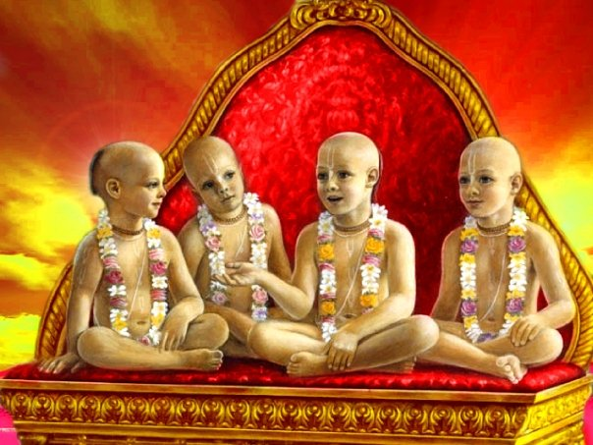
Tapoloka
Notes:
TAPOLOKA
GK saw the 4 Kumaras-attracted by them; GK looked for the Lord but could not find, sages did not answer his questions-silent (meditation); GK kept chanting-Pippalayana asked GK why he wanted to go to Puri. “Just meditate” and you can see Him, Chief of 9 processes is smarana (remembrance). If you want to see the Lord, and can’t focus go to Gandhamadana Hill to see Nara Narayana”
GK was eager, but then the 4 Kumaras showed him many forms of the Lord by assuming different forms. GK begged forgiveness-they touched his head-attained trance
Japa improved-but mind still agitated by thoughts of Vraja. Sometimes in trance GK was unable to see Lord or chant so he was disturbed. Sometimes sages in Tapoloka would assume form of the Lord by intense meditation

Slide 32
Lord in the lotus of the heart
Notes:
form of the Lord in the heart seen in meditation

Slide 33
Notes:
Brahma visited Tapoloka, he was worshipped-GK did not recognize him; The sages described Satyaloka, Lord Brahma’s abode where Visnu is always present on special Vaikuntha planet
Lord as Mahapurusa (thousands of heads). Gopa Kumara wants to go to Satyaloka

Slide 34
Satyaloka
Notes:
Satyaloka
GK saw the Mahapurusa with Laksmi, etc. the Lord was instructing Brahma on devotional service. GK fainted in ecstasy, Laksmi picked him up and brought him to the Lord
Lord took rest, and Brahma did his service of creation; GK stayed and saw at the end of the day Brahma would go to sleep with the Lord. Sages would glorify the Lord while he was sleeping. Lord would sometimes travel elsewhere-GK felt great separation

Slide 35
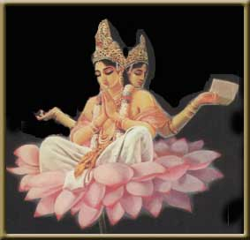
Notes:
One day Brahma touched some foam that came from past devastation-demon appeared-Brahma ran away
Visnu killed demon but Brahma would not come back (scared)-Lord appointed GK as Brahma

Slide 36
Remembering Vraja
Notes:
GK flooded the universe with pure devotional service
But he had many anxieties of management, could not enjoy devotional service as before
Heard that he would have to die after some time-chanted and remembered Vraja
Heard residents of Brahmaloka glorify someone on the earth who became liberated
He asked them about liberation

Slide 37
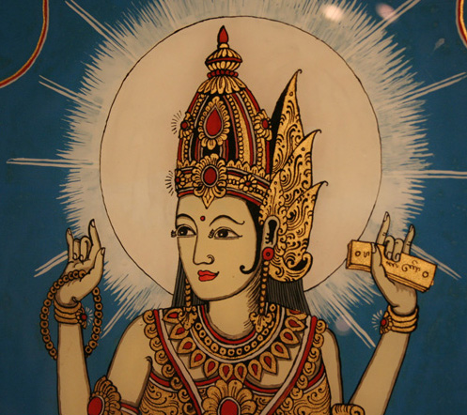
Notes:
Godesses of Upanisads, Srutis, Smritis answered that liberation is attained by knowledge
Some Puranas and Agamas said liberation is aquired easily by devotion service, knowledge is hard to get
Srutis and Smrtis agreed

Slide 38
Notes:
Conclusion: Liberation is discussed in Vedas only to get people to avoid it.
Happiness from liberation is like the happiness of not being sick, or deep sleep, Liberation achieved by Namabhasa
Happiness that comes from knowing the soul is meager
Jivas are part and parcel of Krishna, not Krishna, they forget their real identity in the material world,

Slide 39
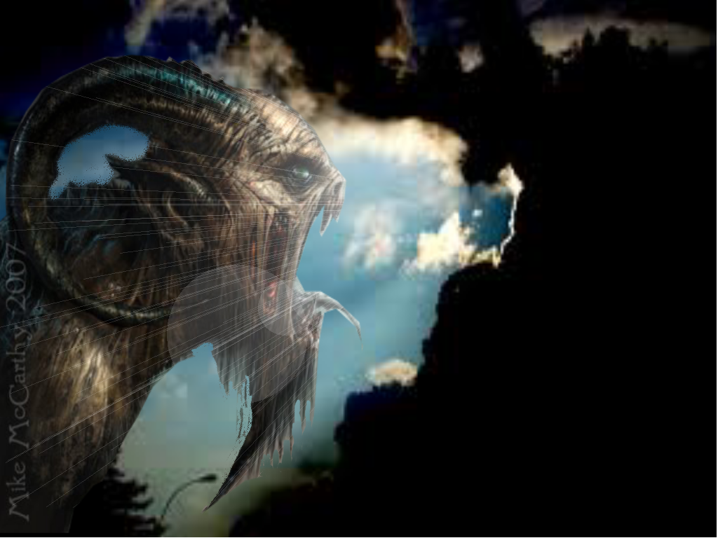
Notes:
Even demons get liberation.

Slide 40
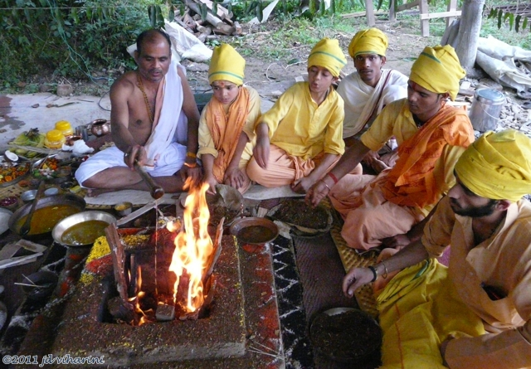
Notes:
Ritual duties distract one, renunciation dries up transcendental taste, knowledge does violence-rectified by bhakti
Goal is prema (absence of satiation)

Slide 41
Notes:
GK advised to worship his mantra,
they described that outside Universal shell (500 yojanas) are 8 coverings each 10 times bigger than last
By crossing these one comes to Mahakala-if you want to quickly go there go to Vraja first
Lord Mahapurusa said: Vraja unaffected by time, you will meet guru there, then go to Mahakala.
Lord Mahapurusa said: After you have satisfied all desires you will play in Vrindavan.

Slide 42
Notes:
Vrindavana
GK returns-Vrindavan looks the same, met spiritual master; Spiritual master-unconscious, embraced, bathed, gave GK instructions on Mantra, disappeared

Slide 43
to the universal coverings
Notes:
GK chanted and traveled upwards-body became transcendental-broke through sphere of sun-overcame illusion; Crossed all planets in blink of eye, reached coverings rich in enjoyment-subtler coverings more enjoyment

Slide 44
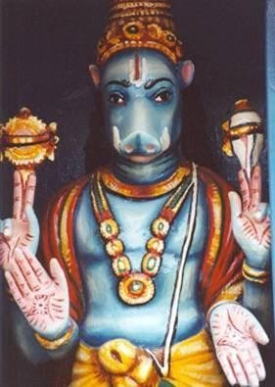
Bhümi worships Varäha
Notes:
First Covering Earth-Lord Boar worshipped by Bhumi-Lord Boar rotating opulences of Universe in hair; Bhumi superior to Lord Brahma, ruler of this first covering, Bhumi received GK as honored guest

Slide 45
Notes:
Water covering with worship of Matsya

Slide 46
from water to fire…
Notes:
Fire-Suryanarayana

Slide 47
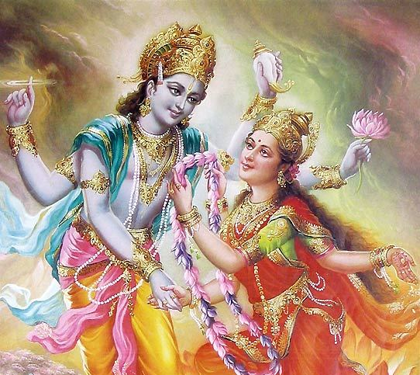
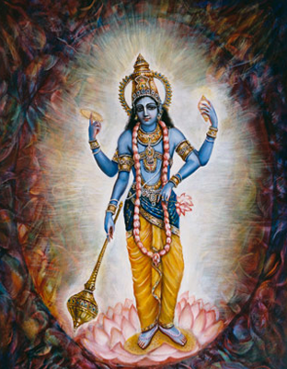
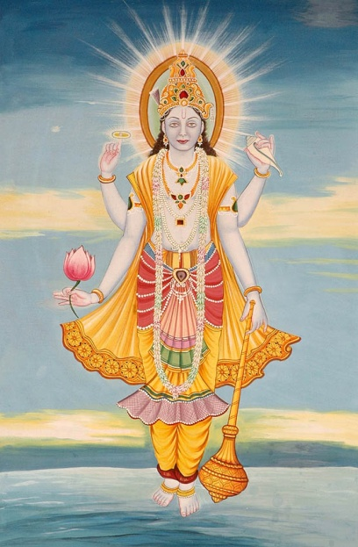
Pradyumna, Aniruddha, Saìkarñaëa, and Väsudeva
air, ether, ego, and mahat
Notes:
Other: Air-Pradyumna,Ether-Anirrudha,Ego-Sankars.Mahat-Vasudev
Demigods each (ruler) superior to the previous

Slide 48
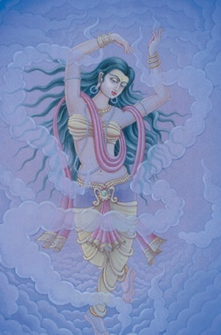
Goddess Prakåti worships Çré Mohiné-mürti
Notes:
Covering of Prakriti- GK arrived, reservoir of Tamoguna, Blue color, Goddess of Prakriti is Mohini Murti; Mohini offered yogic powers to GK and begged him to stay, GK declined but wanted a tour; The entities are made of pradhana and have multiple forms made of 5 tan matras-abstract forms of raw perception

Slide 49
Notes:
[Note: This is an actual picture, unretouched, of Lord Nrsimhadeva in Mayapur showing His effulgence]
Mahakala-crossed beyond prakriti-place of light, so bright struggled to see Lord-Presiding Deity Brahman Acyuta; Light obscured personality of Godhead; GK began to merge into effulgence but the Lord saved him with radiant beams from His toenails; GK confused as to whether this was goal but was saved by the instructions from the spiritual master
GK’s greed to see Madana Gopal increased, and he was disturbed by the fear he might merge; Wanted to return immediately to Vraja but then saw singing, music dancing

Slide 50
Notes:
Saw someone on a bull-white, 3 eyes, naked, ½ mood forehead, trident, bone necklace, Gauri on lap
GK wondered who this was-thought he was like some sense gratifier
Bowed and approached Nandisvara who told him that it was Lord Siva the “Lord of the Universe”
Non different from the Supreme Lord, description of Siva’s position, GK worships Him but still not satisfied
GK not happy because he is not experiencing pastimes of Madana Gopal
Siva manifests Madana Gopal’s pastimes by manifesting His form
GK still not satisfied because even Lord Siva could not imitate Madana Gopal’s charm
GK stayed by side of Siva while Siva rested, then he saw chanting, dancing, Siva’s associates play instruments

Slide 51
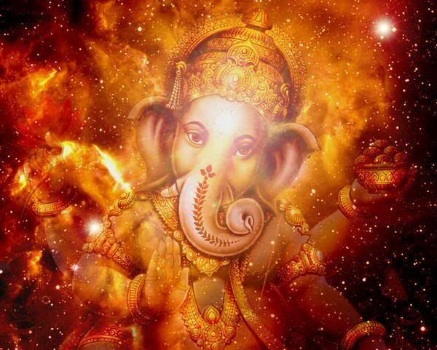
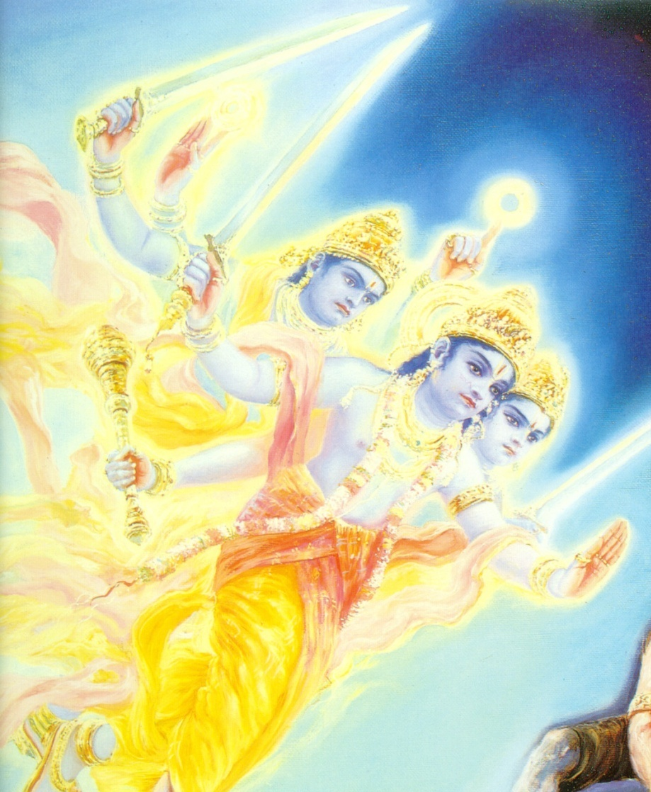
Notes:
Group of 4 armed effulgent persons arrived singing and dancing accompanied by the 4 Kumaras
Uma told Ganesh to explain to GK that these are people from Vaikuntha.
Ganesh explains to GK glorifying Vaikunth, you should go to Vaikuntha
GK faints, Siva picks him up, and says if one gets 100 times the mercy that Siva has, one goes to Vikumtha
Siva says that the abode of Mahakala is not for you

Slide 52
Notes:
Actually the Brahmana in Krishna’s pastimes wanted to rescue his sons from impersonal liberation
Vaikuntha messengers glorify GK and tell him Jayanta (GK’s Spiritual Master-Mathura Brahman) is incarnation
“Go to Vaikuntha by hearing pastimes, especially the Srimad Bhagavam and performing 8 other forms bhakti
Vaikuntha messengers glorify devotional service

Slide 53
Notes:
Vaikuntha messengers said if you want to go to Vaikuntha first go to Vraja and perform Nama Sankirtana
Chanting is the most effect process as it engages all the sense in Krishna consciousness.
Meditation and sankirtana support each other, SKP superior, Sankirtana=prema

Slide 54
Notes:
Vrajabhumi-GK went-heard Bhagavat from a pure brahmana in Mathura
GK saw spiritual master again-embraced more instruction in chanting mantra
GK engaged in ecstatic SKP, saw Krishna momentarily and then He disappeared

Slide 55
Notes:
Airplane arrived with same Vaikuntha people, they told GK to assume a form like theirs
GK refused but his present body was transformed into complete spirit
Flew to Vaikuntha-everyone honoring GK on way, past Mahakala, past Lord Siva

Slide 56
Notes:
Doorway to Vaikuntha- stopped and Vaikuntha men said wait so we can ask permission
GK saw someone like Visnu entered,consorts,GK bowed down-person puts hands in ears, tongue out, “Stop”
Person says, “I am a servant”. Same thing happened with second person who was more opulent, many people same
Some came with families, All were glorifying Lord
Some had different forms, changing: birds,trees, monkeys, demigods, sages, demons
Sometimes place was jeweled sometimes stark white-Brahman was insignificant compared to this

Slide 57
Notes:
GK escorted inside- several doors and doorkeepers-GK thought each manager was Visnu
Escorts described to GK the special signs that only God has (Srivatsa, etc.) and how to behave

Slide 58
Notes:
GK seeing Lord-opulence-4 arms, Kaustubha, Rama on left, Bhumi (Dharani) on right, Sudarsana etc. also there
Associates were with the Lord, Narada, Garuda, Sesa, Narada was entertaining the Lord
The Lord was offering His feet to the devotees
GK shouted; “O Gopala, my life and soul” and ran towards Him
Devotees held GK back, GK cried and became unconscious

Slide 59
Notes:
Visnu said: “Come here quickly.” GK danced
Visnu:“I am very fortunate to meet you..I have been waiting”
“You have passed lifetimes without paying attention to me”
“ I arranged for your spiritual birth, I was so anxious that I myself became your guru Jayanta. Stay here forever.”

Slide 60
Notes:
GK stunned-Flute players dressed as cowherds, affectionate, GK played flute
Laksmi told devotees to leave for Visnu’s lunch but GK had to be persuaded to leave
GK determined to keep opulences away, stayed in same form

Slide 61
Notes:
GK got intimate service, was able to fan Lord and play flute, glorified His activities in Gokula
Other residents sometimes chastised GK that his activities were not proper, Argued glorification inappropriate
GK was discouraged he couldn’t see the pastimes of Gopala

Slide 62
Notes:
Sometimes GK would see Laxmi and Bhara as Radha and Candravali, still he was sad
Sometimes Visnu appeared like Gopal on throne to please GK
GK’s mood disturbed by awe and reverence, GK wanted to embrace, kiss, etc the Lord

Slide 63
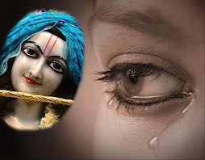
Notes:
Sometimes Visnu went away. Feelings of intense separation
Narada found GK depressed asked GK what the problem was. Touched GK on the head with his vina
GK revealed his mind

Slide 64
Notes:
Narada said Vraja the highest but not compatible with Vaikuntha mode, even though the Lord is the same
Narada explained to GK why the residents of Vaikuntha took different forms: pastimes and “Whatever forms they worshipped Him in before liberation, again assume”
Narada explains; saktavesa avataras, Laxmi, Krishna source of incarnations Narada explains devotees: all equal but some more intimate

Slide 65
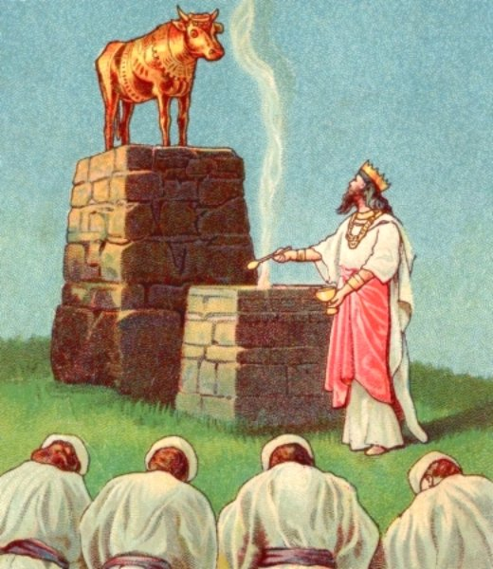
Notes:
GK asks about Deities “Why do the Puranas sometimes deprecate Deity worship?”
Narada explain; that Deities must be worshipped in correct mood, one should not invent forms of worship
Narada explains: sastras belittle those who invent forms, don’t respect devotees, proud, etc.
Narada states; Krishna is subordinate to devotees, describes Mahabhava, Bhakti rare

Slide 66
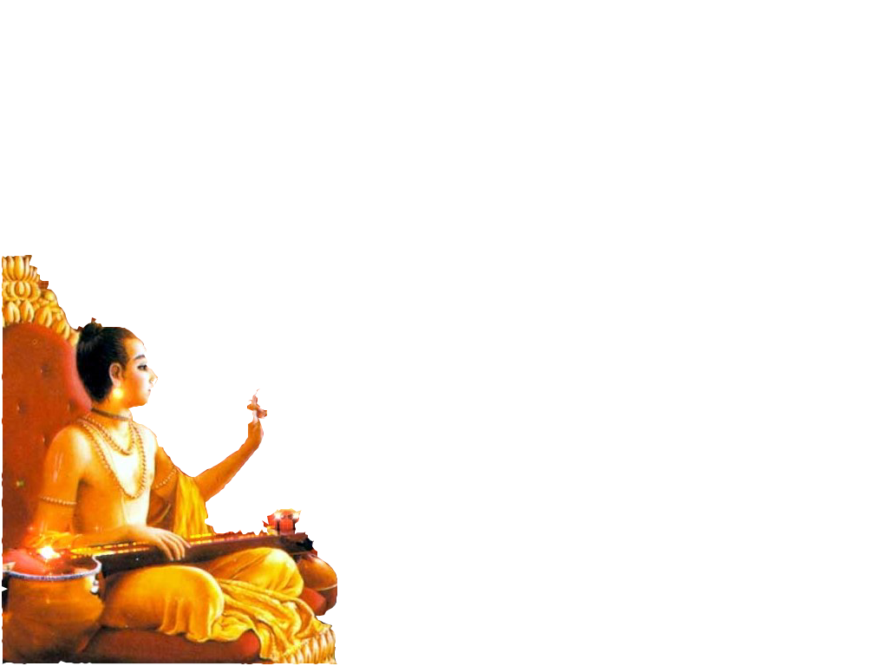
Ayodhya
Notes:
GK: becomes anxious to see Gopala, Narada consoles, Tells him secret
Narada describes Ayodhya (not far from here) and how beyond that is Dvaraka (you should go there)
Narada instructs GK in worshipping Rama: then “Rama will send you to Dvaraka”
Narada: “You don’t need permission to leave here, the Lord told me to instruct you like this, leave immediately”

Slide 67
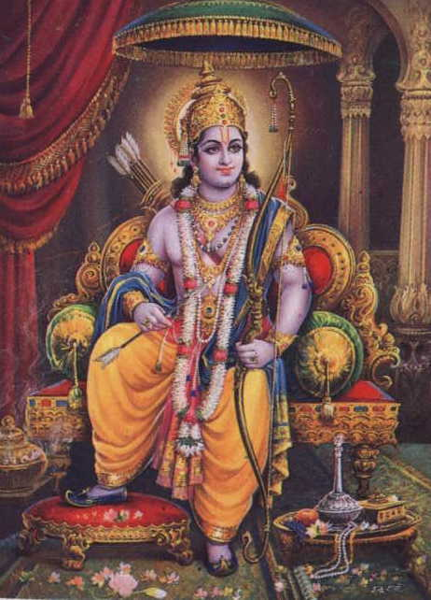
Notes:
Ayodhya-GK saw monkeys chanting Rama!, monkeys grabbed GK’s flute and Hanuman escorted to Ayodhya
GK saw Bharata and others, thought that Bharata was Rama, Bharata covered His ears, “I am a servant.”
Hanuman brought GK to Sri Rama, Sita, and Laksman-GK offered obeisances, Rama picked him up
Hanuman serving and fanning the Lord.
GK bowed to Rama, Rama addressed him as dear friend.
“Get up” “Give up this reverence”
Hanuman brought him to Rama’s lotus feet
Observed Rama’s pastimes, missed pastimes of Gopala
Imagined Rama to have the qualities of Gopala
Vraja imposed itself on the heart of GK-Hanuman pacified him
Rama noticed this and sent GK with Jambavan to Dvaraka; “Go to Dvarka and be happy”

Slide 68
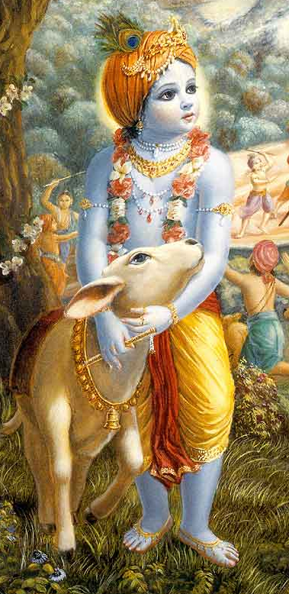
Notes:
GK bowed to Rama, Rama addressed him as dear friend.
“Get up” “Give up this reverence”
Hanuman brought him to Rama’s lotus feet
Observed Rama’s pastimes, missed pastimes of Gopala
Imagined Rama to have the qualities of Gopala
Vraja imposed itself on the heart of GK-Hanuman pacified him
Rama noticed this and sent GK with Jambavan to Dvaraka; “Go to Dvarka and be happy”

Slide 69
Dvärakä
Notes:
Dvaraka-GK saw Yadavas-most attractive persons
Yadavas embraced him and brought him into the city

Slide 70
entering the gate of Dvärakä
Notes:
Saw Krishna in the Sudharma hall with 2 arms-Adolescent

Slide 71
Notes:
With Him were Vasudeva, Balarama, Akrura, Gada, Satyaki, Ugrasena
Narada was entertaining Krishna with jokes
Uddhava was massaging Krishna’s feet, Garuda praying

Slide 72
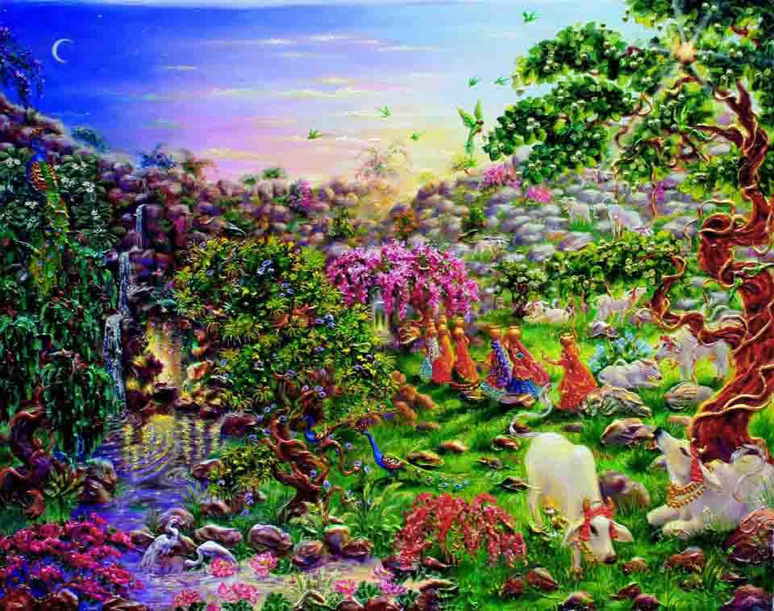
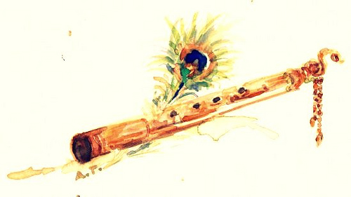
Notes:
Lord told Uddhava to bring GK close, Lord put feet forward, Uddhava forcibly put head of GK on feet of Lord
Lord touched GK, took flute out of GK’s hands, Lord shed tears holding flute and remembering Vrindavana

Slide 73
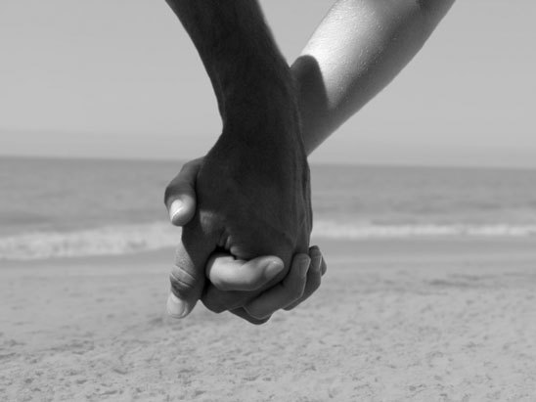
Notes:
Lord asked about GK’s health, Lord disturbed thinking of Vrindavana, ministers calmed Lord
Lord entered His inner quarters holding GK’s two hands with Balarama and Uddhava
Devaki, Rohini, and wives followed

Slide 74
Notes:
GK had vision in which Krsna appeared as Madana Gopala, Devaki as Yasoda, etc.
Krishna lifted GK up and cleansed GK’s body.
Krishna did not want to eat because He was feeling separation from Vrindavana. But mothers forced Him to eat
Krishna personally fed GK and then ate Himself

Slide 75
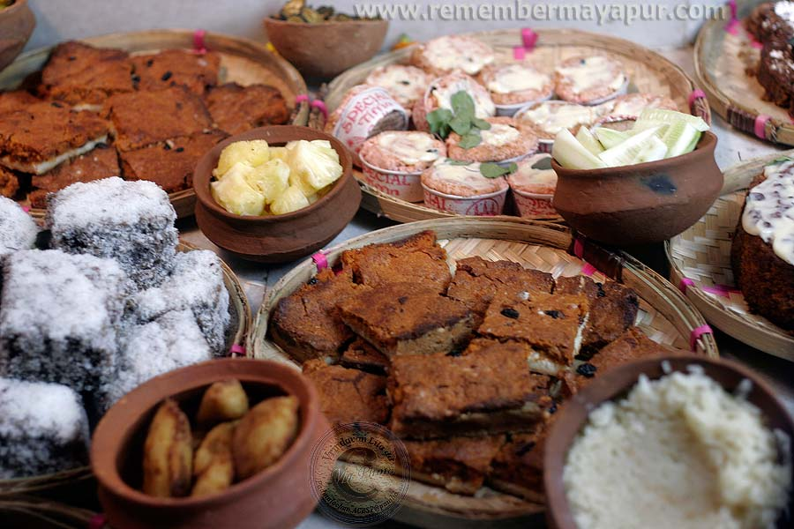
Notes:
Krishna and Balarama sat down with Yadus, looked like Krishna and cowherd boys
Uddhava took GK to his house to stay. Uddhava gave GK a lot of Mahaprasad.
GK got a lot of mercy while he was there

Slide 76
Notes:
Residents of Dvaraka spoke to GK: “not appropriate for you to continue dressing like a miserly forest character”
GK insisted on maintaining his dress and appearance.
Sometimes GK would see Krishna with 4 arms and sometimes Krishna would leave to visit the Pandavas
GK tormented by separation-relieved by meeting Krishna

Slide 77
Notes:
Narada came to visit Uddhava’s house and GK
GK asked Narada a question: “Why do I see you everywhere (heaven, Vaikuntha, Dvaraka)?
Narada replies that Krishna’s servants also expand like Krishna-Garuda, Hanuman etc
Krishna’s paraphernalia also expands.
Narada is amazed that GK always stays the same wherever he is!
GK told Narada: “You know everything about this.”

Slide 78
Notes:
Narada to Uddhava: “Just see this cowherd is seeking after something unobtainable by persons like you or me.”
“Wandering here and there, he has never transcended distress”
Narada speaking to Uddhava: “Why don’t you enlighten him?”
“Vrindavan is far away and the happiness inaccessible, we can only pray for a means to attain it

Slide 79
Notes:
Uddhava describes GK’s birth, occupation and worship: “He is a much greater soul than us”
Narada embraces Uddhava
Uddhava thinks himself unqualified to describe as he is Ksatriya
Narada laughs at this.
Uddhava explains that even here in Vaikuntha the Lord follows this system
Narada laughs appreciating the charm and glory of the Lord’s pastimes.
Narada praises the Lord for becoming an intimate friend and is curious to see His pastimes in Dvaraka, ecstasy

Slide 80
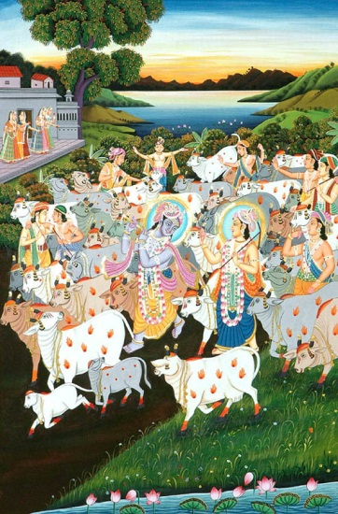
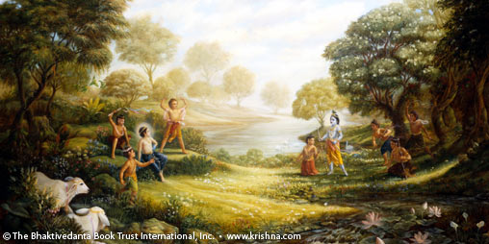
Goloka: Land of cows
Notes:
Narada begins to explain Goloka-far away, beyond Vaikuntha
Mathura is present along with Vrindavana and other forests of Vraja
Goloka means land predominated by cows, not attainable by one who is absorbed in awe and reverence
Prema is only obtainable when one thinks of the Lord intimately
Ayodhya and Dvaraka similar to Vaikuntha, Goloka greater and far away
Gokula of Mathura is also supremely great-Narada describes when Krishna descends to Gokula

Slide 81
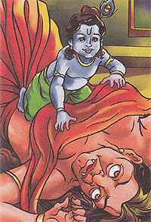
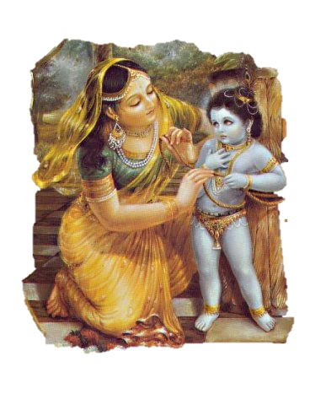
Notes:
Krishna leaves all of His associates and paraphernalia behind in all His abodes when He descends
That is why the “Lord of Vaikuntha” disappears sometimes
Vrindavan glorification: desire trees, kindness to Putana, Damodara pastimes,, dancing entertaining ladies
Krishna’s beauty robbed the gopis of the soberness, people curse Lord Brahma for making eyes with lids
Krishna has 3 ages: kaumara, pauganda, kisora/ unexcelled pastimes

Slide 82
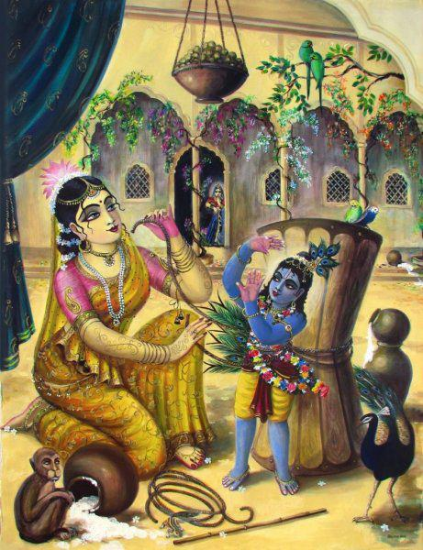
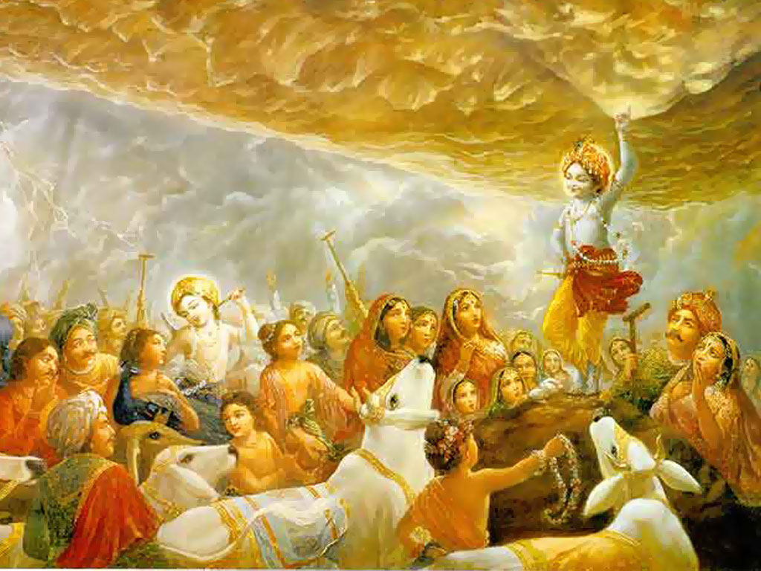
Notes:
Pastimes described by Narada:
Cart demon, universe mouth, Trnavarta, Mucanchora, eating dirt, Damodara, Vastasura, flute, Aghasura
Lunch, Brahma vimohana lila, imitating bees, honoring Balarama, tending cows, Dhenukasura, Kaliya
Forest fire, Prahlambasura, rainy season when Krishna eats white radishes sitting on the base of a tree
Flute, stealing Gopi’s clothes, begging food brahmanas, Govardhana lila, Nanda Varuna saving,
Flute song better than Vedas-everything in universe stops
Men offer obeisances to Gopi wives, Radharani, Rasa dance

Slide 83
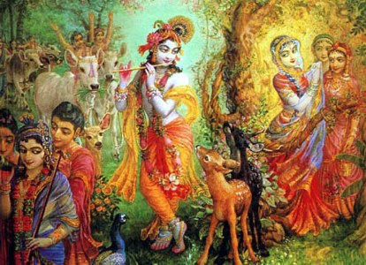
Notes:
Krishna disappeared from Rasa dance, Krishna indebted to Gopis, Gopis praise flute
Narada said Krishna is enchanted with forest dwellers who control Krishna with herbs and mantras (jealous)
Krishna bewildered by residents of Vraja so He forgets duties, Narada has to remind Him

Slide 84
Leaving Vrindavana
Notes:
Akrura forced Krishna to leave Vrindavan
Krishna comes back immediately in His eternal pastimes
Sometimes Krishna hides Himself from the residents of Vraja-Vipralamba
Goloka=Gokula, In Gokula not everyone can see Him all the time, appears occasionally at other times to devotees
Goloka everyone sees Him always

Slide 85
Notes:
Narada praises GK’s eagerness, this is very very rare
Narada said methods of obtaining different goals is different
Narada says: “I am not a fit person to go further--- Uddhava is

Slide 86
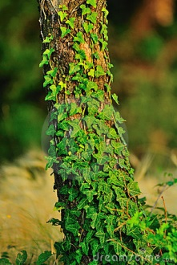
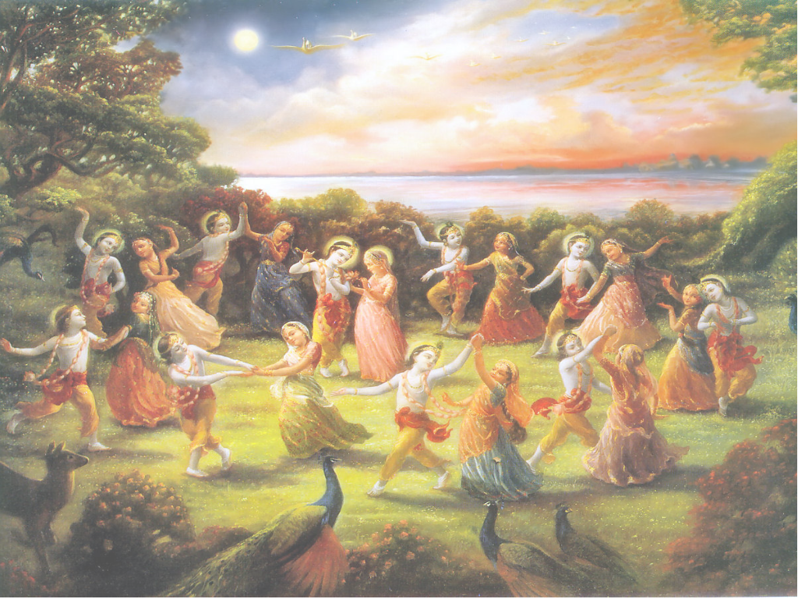
Notes:
Uddhava speaks touching Narada’s feet
Glorifies Gopis, Uddhava wants to become dust, or creeper, etc., He describes the Rasa lila

Slide 87
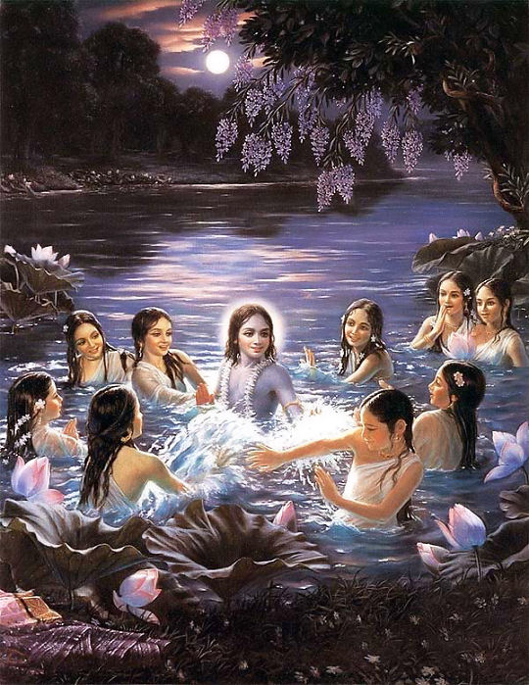
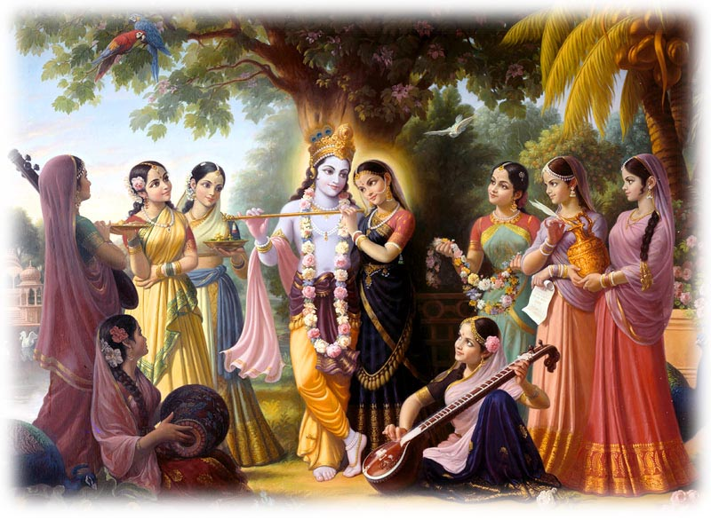
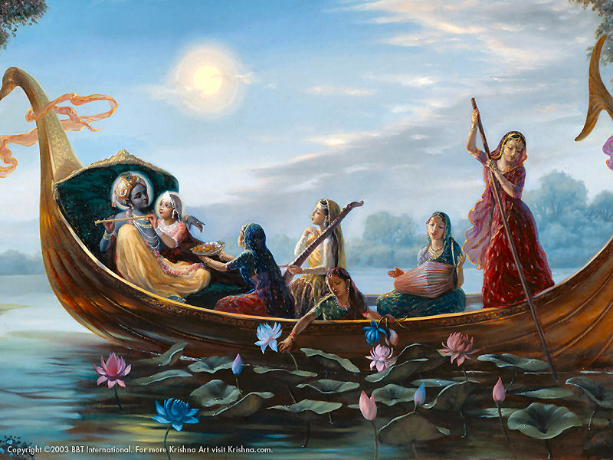
Notes:
Narada-glorifies Uddhava, Rukmini can’t achieve the Gopi’s fortune
Narada expressed his inability to describe Gopis, but Narada said his tongue is wicked and will do it
Narada says that Uddhava has witness these things, Akrura describes Gopis, Bhisma (eternal celibate) desc. Gopis
Narada embraced GK, Narada fainted trembled, bit tongue, danced like a Madman
Narada said that all these matters should be private, “That is why I did not reveal it earlier”
Narada describes Purussottama in Vaikuntha, sometimes same sports as Vrindavan
Lord Jagannatha exhibits whatever form a devotee worships: “Go there, at least it is means to your end.”

Slide 88
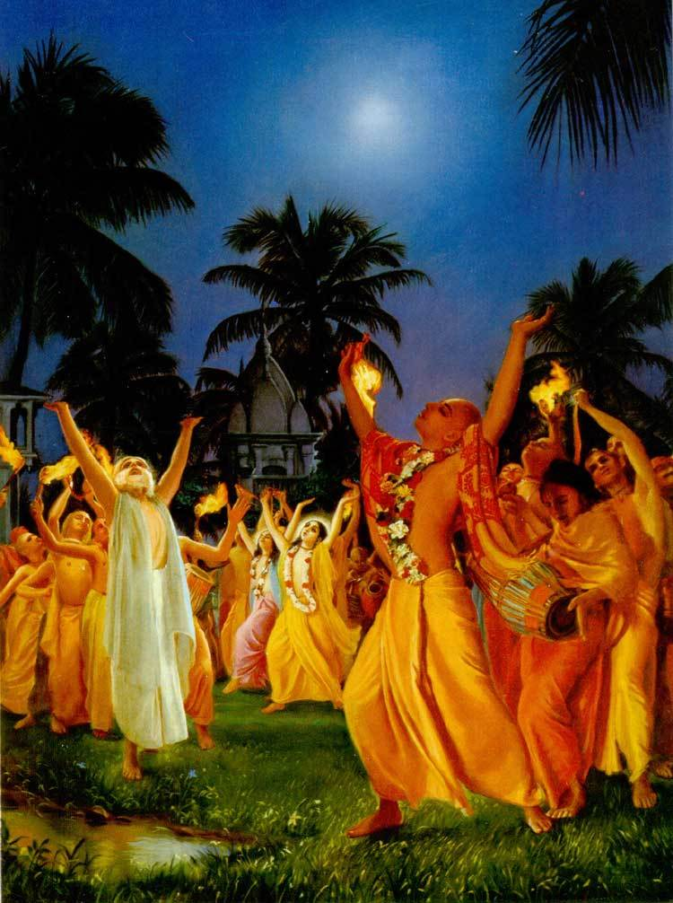
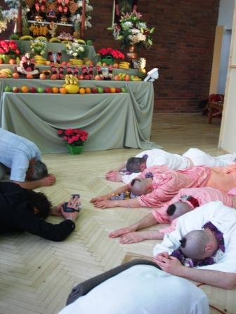
Notes:
Narada describes the means to obtain prema:
Strong desire, overcome obstacles, meditate and sing about pastimes in Vraja (SKP), keep association with those who have prema
keep prema concealed, reside in holy place
utter humility
think oneself incapable and lowly
cultivate speech in that mood
highest humility in the Gopis
prema and dainya(humility) are cause and effect of each other

Slide 89
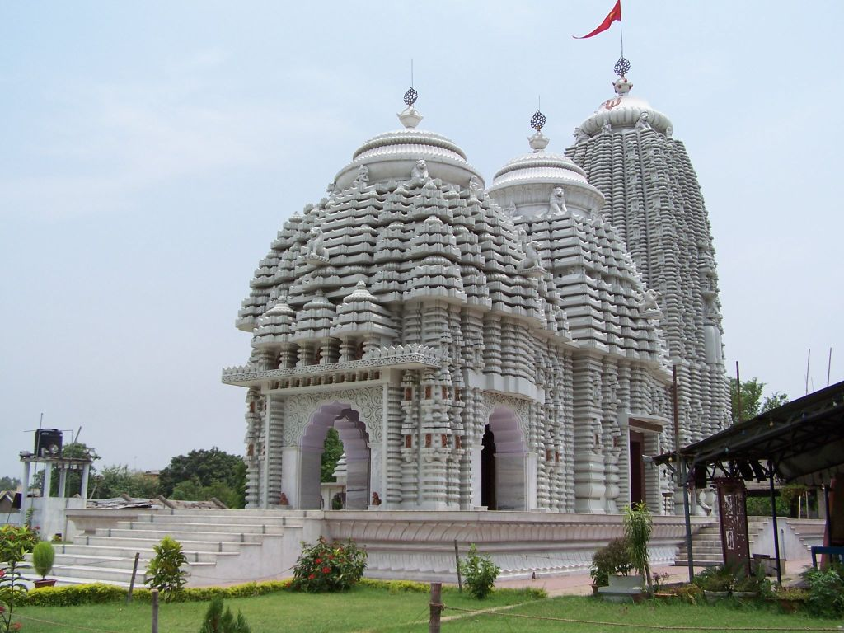
Go to Jagannatha Puri
Notes:
symptoms-external trembling, insanity
Prema is abundance of ecstasy and full of the worst suffering
Prema without ecstasy is like spinach without salt, fruitless trees
Narada describes separation of Gopis when Krishna left Vrindavan
Radhika is personification of prema-you can ask her about prema
Or you could approach an incarnation of Krishna in Her mood who preaches
“Go to Jagannatha Puri”

Slide 90
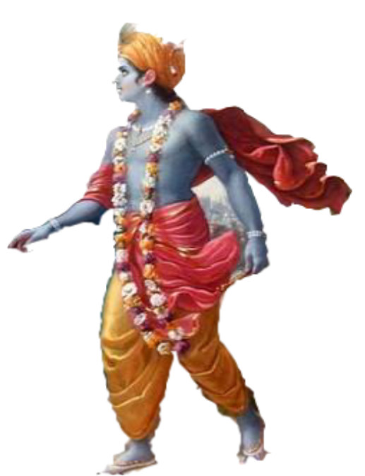
Notes:
Uddhava disagrees with Narada that Puri is better than Dvaraka
Uddhava states that the disadvantage in Puri is that there are dramas of Vrindavan pastimes –causes sorrow
Also environment is too disturbing and enjoyable
“You will not get humility there”- “you must go to Gokula”
“Lord Jagannatha sometimes leaves Puri to go to Gokula”
Describes Gokula-crying and pure love

Slide 91
Notes:
Narada is pleased and praises Uddhava’s advice
Narada advises GK to go to Goloka praises GKfor his simplicity
Uddhava says that normally you would have to ask permission from Dvarkanath to leave, but not nec for Gokula
Uddhava actually went to V externally to console residents but actually to learn from them

Slide 92
Notes:
Yamuna River
Ud says that Krishna Himself will take you to Gokula/GK closes eyes and opens them in Gokula
In Gokula GK engages in SKP/experiences ecstacy alternativing with great distress
One time crying became unconscious, Krishna came and wiped dust from his face
GK tries to grab K’s dhoti, Krishna runs away from him playing flute.
GK faints-falls into the Jamuna-

Slide 93
Notes:
transported by vehicle, past Vaik, Ayodhya

Slide 94
Notes:
Nandagram
Arrived in Goloka, surprised that it appears just like Gokula.
Heard about Kamsa even there
GK tries to speak to residents but not paying him any attention/heard songs-GK puzzled by crying
GK asked where K was, old lady said he come back after herding cows

Slide 95
Notes:
Heard flute-Everyone experienced ecstacy

Slide 96
Notes:
Krishna ran to GK seized him and fell to ground/K crying profusely unconscious
Gopis upset, thought that GK was a wizard of Kamsa
Everyone upset-GK put K’s feet on his head
Balarama came and made GK hold K’s head/made GK lift K, K embraced and kissed GK
K took GK’s hand in hi and entered village

Slide 97
Notes:
Went home w/K. Yasoda showed him love
Sarupa is his real name
Gopis came and bathed Balarama, then bathed K. K threw flute to S to avoid Gopis stealing it
Bathing pastimes, then eating, S sat with K and Balarama
Krishna was being fed, He also fed S
K acted like He did not like Manohara laddus given by Radha so He gave them to Sarupa
Sudama is the brother of Radha-Sarupa is a member of the same family
Krishna gave pan He chewed to Sarupa/Krishna went to bed
Radha offered pan, Candravali and Lalita massaged feet
Sridama came and took Sarupa away.
At dawn Sarupa returned and saw Krishna’s body has signs of conjugal love
Mother Yasoda attributed disarray to something else like thorns in the forest
Yasoda complained about K’s disheveled condition saying Gopis did not bathe him properly

Slide 98
Notes:
Krishna got up and left with the cows playing His flute and buffalo horns
Krishna was sweating in the sun but actually was sweating because He longed to be with the Gopis
Gopis tried to follow Him, Krishna sent them back and then sent Nanda Maharaja back
Krishna felt more pain that Gopis due to separation
Krisna derives more pleasure in forest than in the town of Vrindavana.
Happiness of Goloka is superior

Slide 99
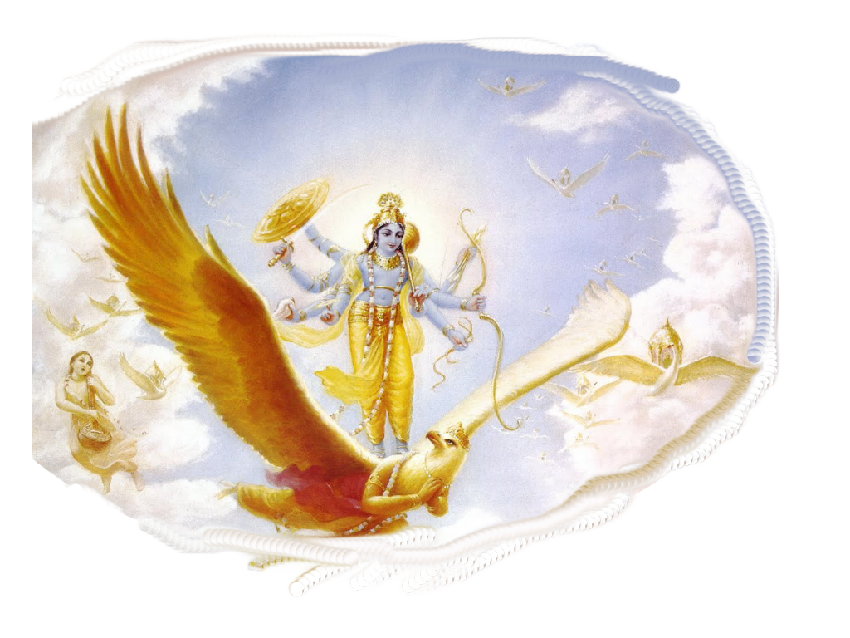
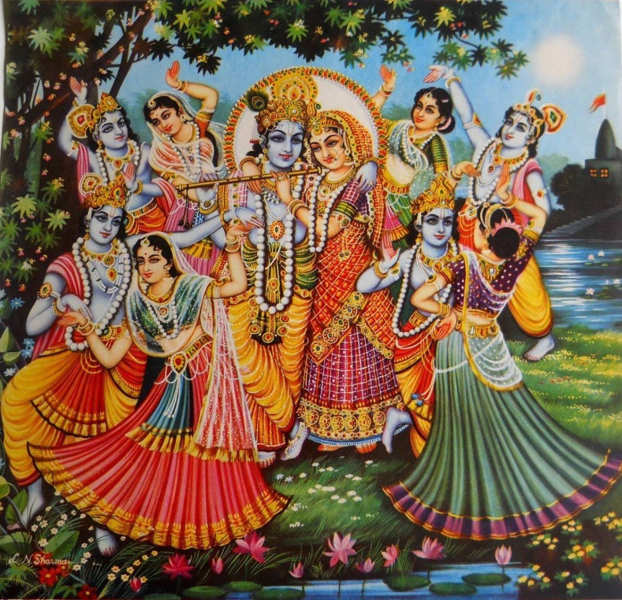
Notes:
Eternal Associates in Vaikuntha are expansion of Goloka devotees-demigods expansions, shadow or empowered
Sridama expands as Garuda/Vasudeva and Devaki as Sutapa and Prsni also as Kasyapa and Aditi
When Krishna’s devotees like Radha appear in Goloka all the other expansions merge in her
Each resident of Goloka thinks that he is most dear to K except Gopis who are most dear
Gopis in their utter humility considers herself worst maidservant

Slide 100
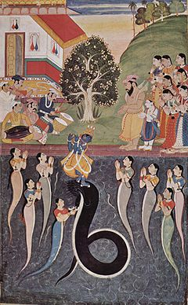
Notes:
Kaliya story: Krishna sent old man through telepathy to tell the Vrajavasis, Bala told Krishna to stop playing
Because it would kill the Vrajavasis, Krishna danced with Gopis on Kaliya’s heads, Krishna took the
Shawls of Nagapatnis made a rope and put through Kaliya’s nose, mounted Kaliya just like a horse, playing flute, whipped Kaliya with the flute, Nagapatnis gave Him gifts/ Krishna bless Kaliya to become like
Ananta.

Slide 101
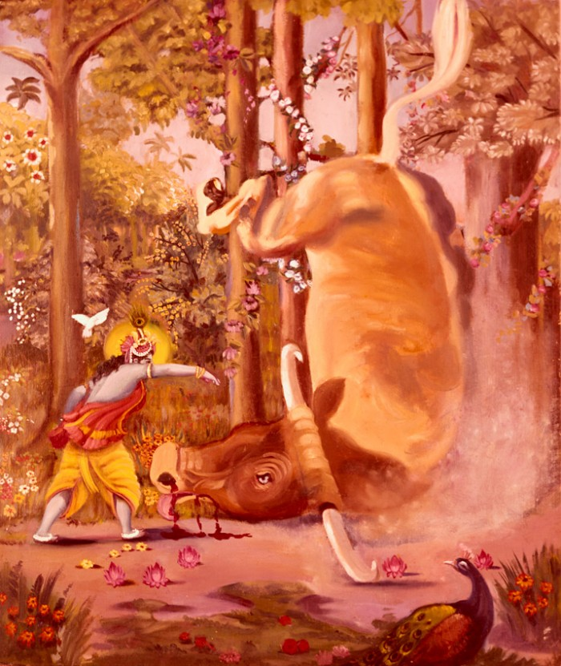
Notes:
Arista Story: Krishna offered Arista (He made whole in nose) to Gopisvara Mahadeva as Nandi

Slide 102
Notes:
Kesi story: Krishna kicked him away and then tamed him and made him jump for pleasure of cowherds

Slide 103
Notes:
Akrura came to get Krishna/ people criticized Nanda and Yasoda
Krishna snuck off to be with the gopis from chariot
Bala leads Akrura to where Krishna is and Akrura convinces Krishna to come
Gopis chastise Akrura. Krishna decides to go/ Gopis try to convince Krishna not to go
Krishna went to Mathura and did the killing and sent Nanda Maharaja back
Vasudeva argued that Krishna should stay because it was the time for His initiation

Slide 104
Notes:
Radha had ordered Sarupa to enlighten the Mathura Brahmana
Sarupa sometimes resides in Goloka and sometimes in Gokula.
Sarupa projects his feelings on others
Radha had ordered Sarupa to preach to Her devotee

Slide 105
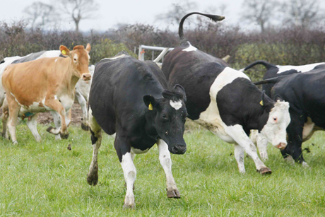
Notes:
Seeing the Brahman still did not have prema, Sarupa puts his hand to his head. Gets prema.
Glories of pure devotional association/now he gets pure love, ecstasy
Flutes and cow sounds/ two ran to Gopala

Slide 106
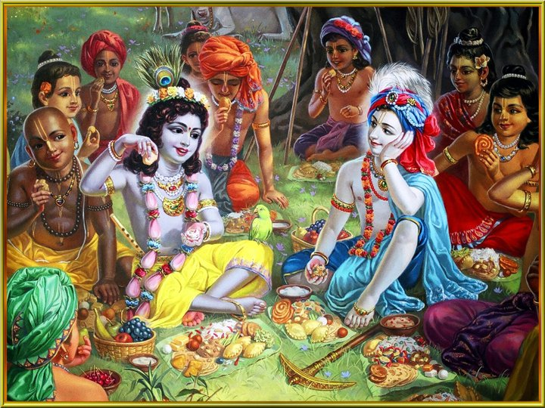
Notes:
Obeisances. Krishna and fell on top, embraced them, called Mathura Brahman-Janasarma
Krishna decorated Brahman with his own garments, Krishna gave him a cowherd form
Krishna watered the cows and played in water with friends. Lunch with Krishna and Balarama
Krishna served the boys concentric circles. Forest fruits and roots and food given by mothers
Krishna ate from each plate, fed boys from each other’s plates
Boys fed Krishna/put on garlands/ sandalwood
Krishna slept, Sridama arms are the pillow
Krishna makes faces and jokes and made everyone laugh
Krishna entered Vrindavan and turned Janasarma over to Sarupa

Slide 108
Notes:
Sanatana Goswami

