Slide 1
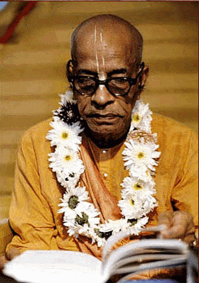
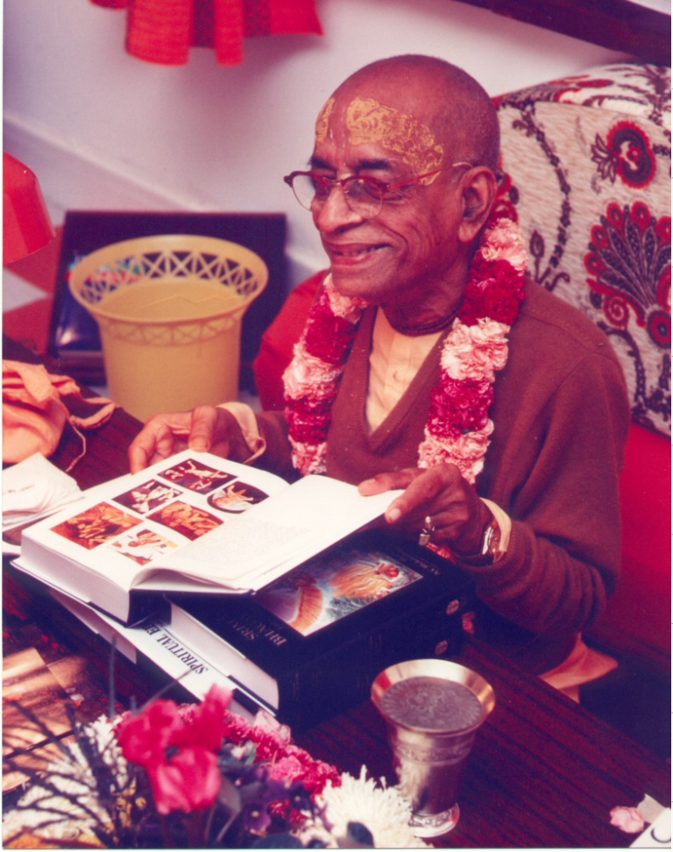
How to study Sastra more deeply
The 12 aims of Sastric Study

Slide 2
Prabhupada comments: "All the devotees connected with the Krishna consciousness movement must read all the books that have been translated (the Caitanya-caritämrta, Srimad-Bhägavatam, Bhagavad-gitä and others); otherwise, after some time, they will simply eat, sleep and fall down from their position. Thus they will miss the opportunity to attain an eternal, blissful life of transcendental pleasure.“Caitanya-caritämåta, Madhya 25.278)

Slide 3
Approach the sastra with respect and reverence!!
Prayers to Srimad Bhagavatam by Sanatan Goswami from Sri Krishna Lila Stava
paramänanda-päöhäya prema-varñy-akñaräya te
sarvadä sarva-sevyäya ñré-kåñëäya namo `stu me
O Çrémad-Bhägavatam, I offer respectful obeisances unto You. By reading you one attains transcendental bliss, for Your syllables rain pure love of God upon the reader. You are always to be served by everyone, for you are an incarnation of Lord Kåñëa.
mad-eka-bandho mat-saëgin mad-guro man-mahä-dhana
man-nistäraka mad-bhägya mad-änanda namo `stu te
O Çrémad-Bhägavatam, O my only friend, O my companion, O my teacher, O my great wealth, O my deliverer, O my good fortune, O my bliss, I offer respectful obeisances unto you.

Slide 4
KNOWLEDGE
Knowledge (memory and recall)
Understanding
SKILLS
Personal application
Theological application
VALUES AND ATTITUDES
Faith and conviction
Mood and mission
Realization
Preaching application
Evaluation
Authority
Academic and moral integrity
Responsibility for learning

Slide 5
Higher thinking skills and values
Realization
Application
Understanding
Theoretical Knowledge

Slide 6
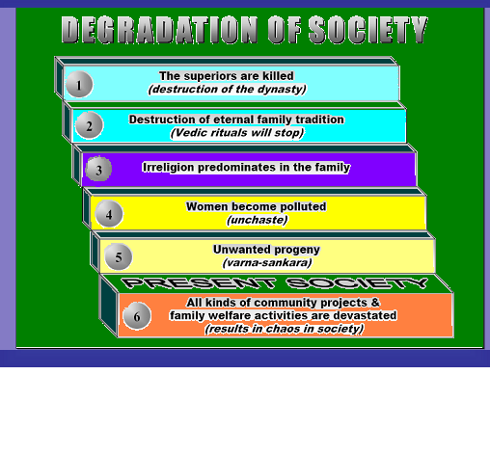
KNO Knowledge Memory and Recall
Memorize and recall the (theoretical) knowledge which forms the foundation of an ongoing progress in Krishna Consciousness.

Slide 7
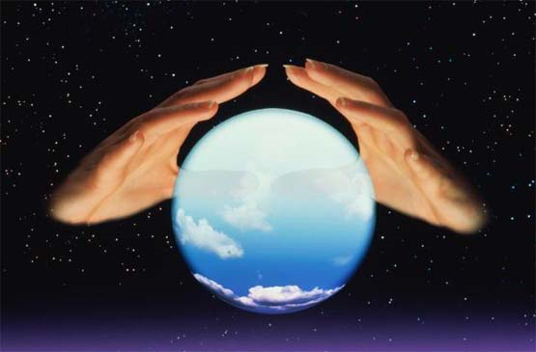
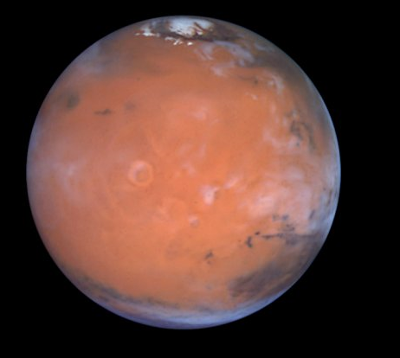
The 12 Aims
Faith and Conviction
Authority
Theological Application
Evaluation
FATE
Mood and Mission
Academic and Moral Integrity
Responsibility for
Learning
Sastra Caksus/
realization
KUPP
Knowledge
Understanding
Personal application
Preaching application
MARS

Slide 8
What are the uses of basic, theoretical knowledge?
In your personal life?
For preaching?
In terms of future learning?

Slide 9
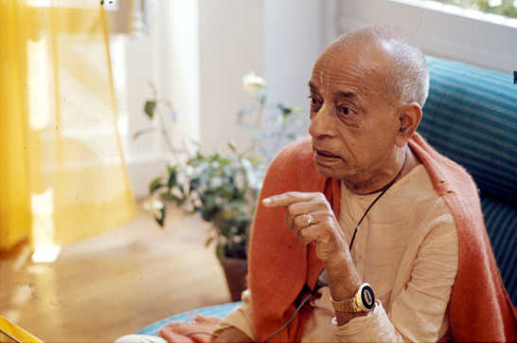
“The process is that you should memorize the purports of my books and then speak them in your own words. Do not adulterate or change anything. Then you will be the perfect preacher.”
Letter, 15 Nov. 1975

Slide 10
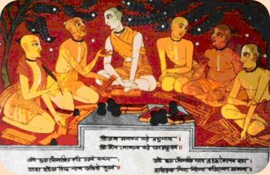
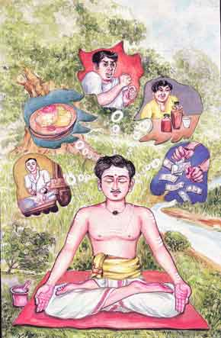
UND Understanding
To deepen understanding of the Krishna consciousness theology, particularly through studying it from a wide range of perspectives and through developing thoughtfulness and introspection.

Slide 11
One who sees inaction in action, and action in inaction, is intelligent among men, and he is in the transcendental position, although engaged in all sorts of activities.

Slide 12
Choose one verse/passage which you find difficulty in understanding — examine and explain what you don’t understand.
Identify and write down questions which, if answered, would help you to better understand the subject.

Slide 13
Thus I have explained to you knowledge still more confidential. Deliberate on this fully, and then do what you wish to do. BG 18 :63

Slide 14
Discussion:
The kåpaëas, or miserly persons, waste their time in being overly affectionate for family, society, country, etc., in the material conception of life. One is often attached to family life, namely to wife, children and other members, on the basis of "skin disease." The kåpaëa thinks that he is able to protect his family members from death; or the kåpaëa thinks that his family or society can save him from the verge of death. Such family attachment can be found even in the lower animals, who take care of children also.

Slide 15
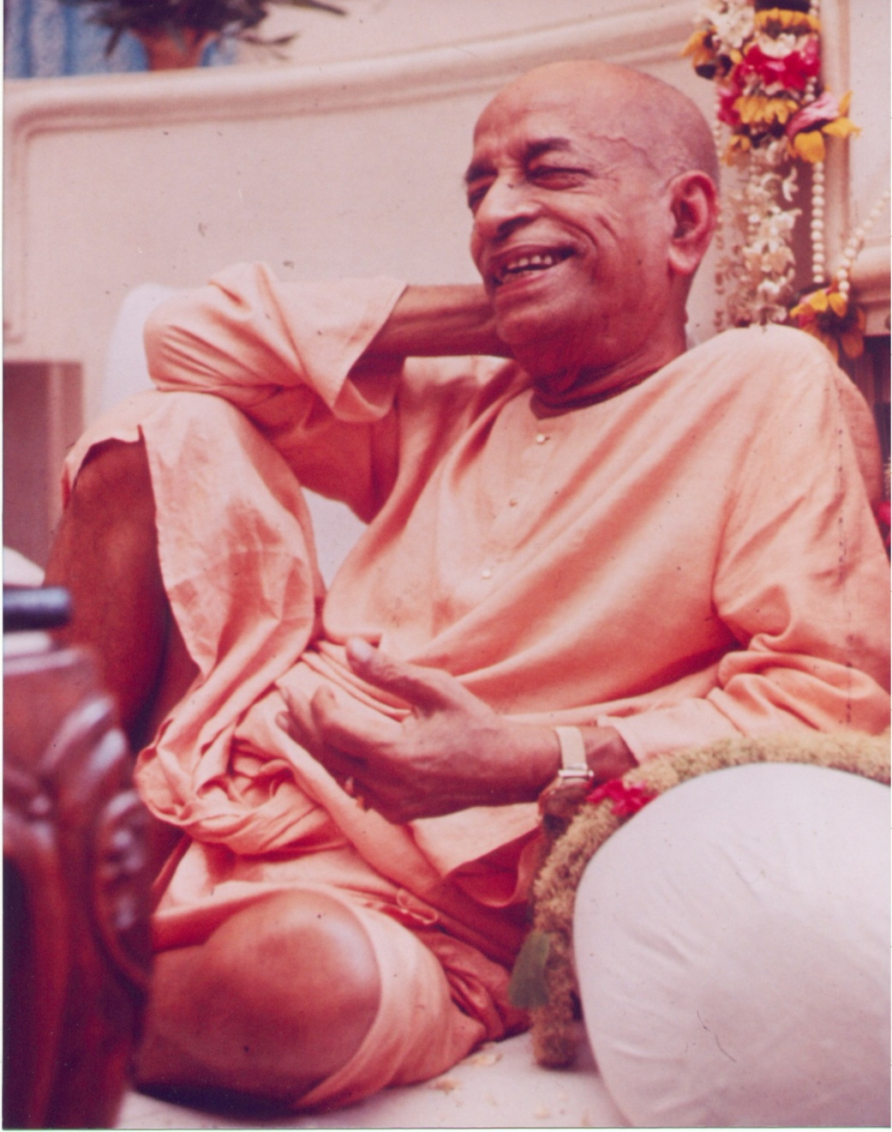
It is not blindly accepted, this Krishna Consciousness. With considerable deliberation, we take the decision.
Lecture BG 7 1-3, Dec 14, 1972

Slide 16
Understanding can also be in relationship to other aspects of study and application
Men of small intelligence worship the demigods, and their fruits are limited and temporary. Those who worship the demigods go to the planets of the demigods, but My devotees ultimately reach My supreme planet. BG 7:23
Demigod worship
Personal understanding
Preaching
understanding

Slide 17
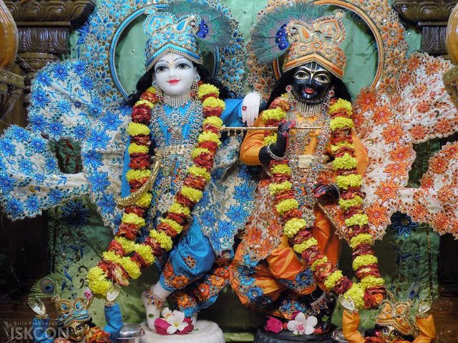

Slide 18
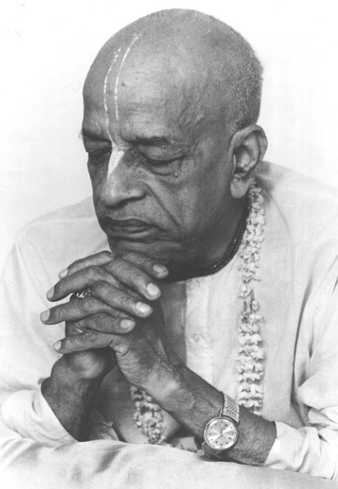
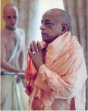
PeA Personal Application
To apply the Krishna Conscious theology, with reference to:
External practices &
Internal development
And to develop appropriate Vaishnava qualities and behavior

Slide 19
Are you able to:
Explain how sastra applies to your life? (i.e. Explain, based on sastra, how following the four regulative principles is beneficial for you. Or apply BG 2:14 when in distress.)
Identify, through sastra, your personal level of spiritual advancement and identify which passages apply to you?
Change your opinion and behavior on the basis of sastra and give up misconceptions you may have about certain sastric principles and passages. Realize that there may be more than one way to apply a verse.
Identify and express doubts then seek relevant guidance.

Slide 20
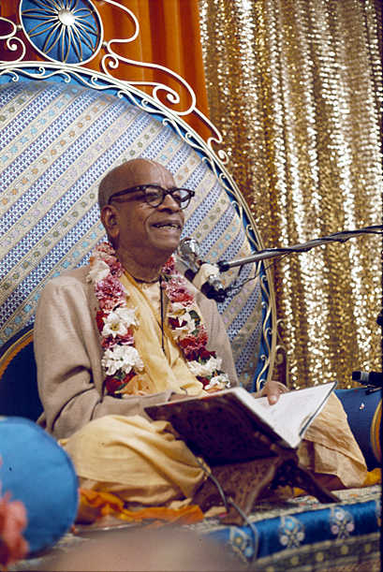
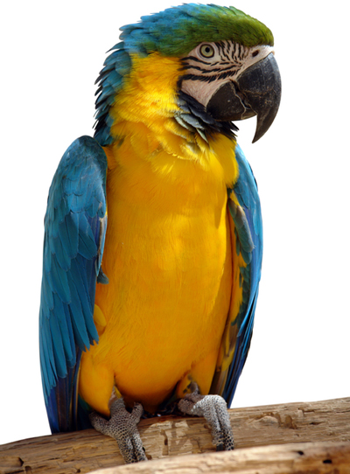
Simply quoting verses, like a parrot, will not be very much beneficial. One must apply, jïänam vijïäna-sahitam. Jïäna means to know the thing, and vijïäna means to apply the things in practical life. Jïänaà vijïäna-sahitam. So we must know the vijïäna, how practically. That is taught by the Gosvämés, Lec. NOD 73
As a person puts on new garments, giving up old ones, the soul similarly accepts new material bodies, giving up the old and useless ones.

Slide 21
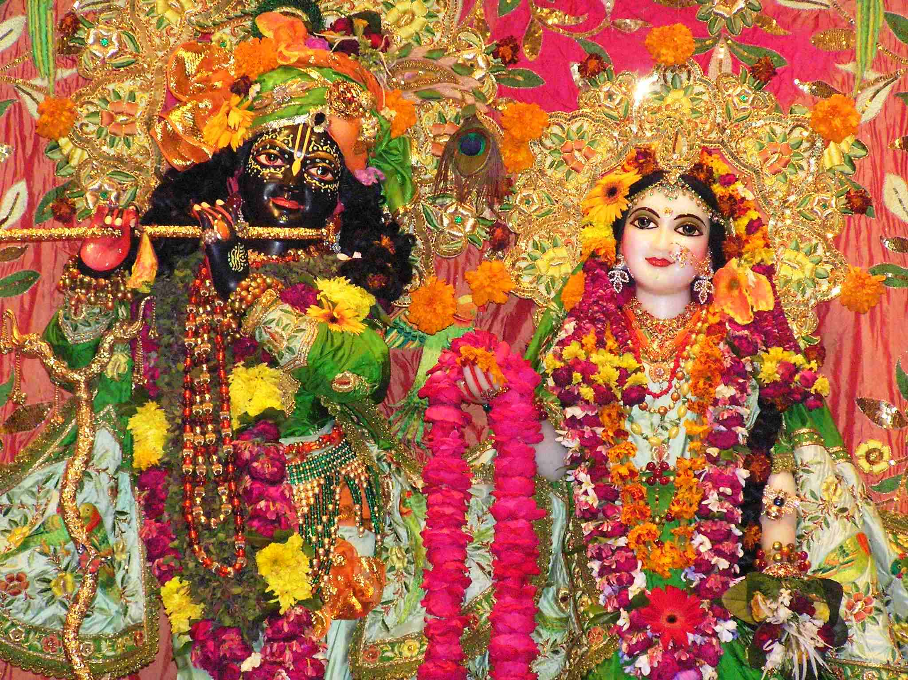

Slide 22
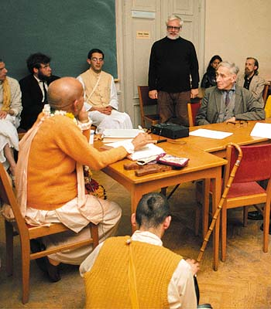
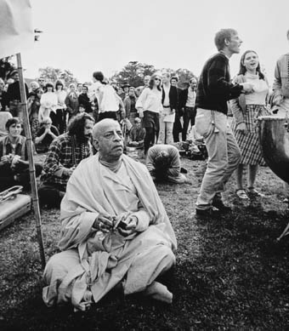
PreA Preaching Application
To enhance devotees’ desire and ability to preach effectively.

Slide 23
Are you able to:
Choose texts from Sastra that apply to a particular topic about which you will preach?
Express sastric understanding in your own words?
Be sensitive to your particular audience
Remain faithful to sastric conclusions
Present sound, logical arguments and also be tactful and compassionate.

Slide 24
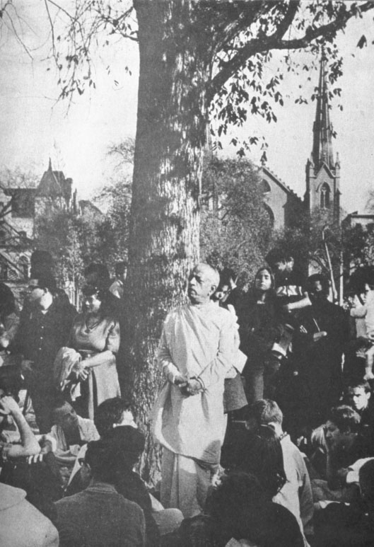
I wish to encourage all my disciples to very carefully learn this philosophy of Krishna consciousness because there are so many preachers who will be required to bring this message to all corners of the earth..Letter LA 7 Feb. 1969

Slide 25
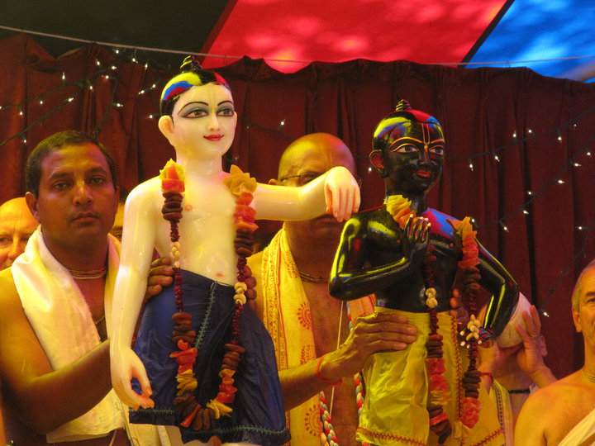

Slide 26
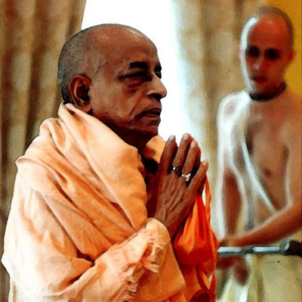
F & C Faith and Conviction
To build and maintain students’ faith and conviction in:
The process of Krishna Consciousness
The Sastra and its foundation

Slide 27
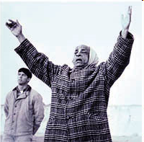
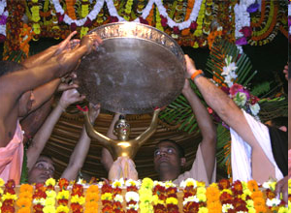
How is faith created by association with devotees?
Faith
Faith
Faith is the complete conviction that simply by serving the Supreme Lord, Sri Krsna, one can achieve all perfection. …After reading Bhagavad Gita one should give up all other engagements and adopt the service of the Supreme Lord, Krsna, …if one is convinced of this philosophy of life, that is FAITH.

Slide 28
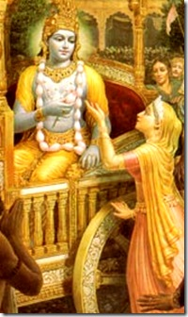
Queen Kunti Prayed: I wish that all those calamities would happen again and again so that we could see You again and again, for seeing You means that we will no longer see repeated births and deaths. SB:1:8:25

Slide 29
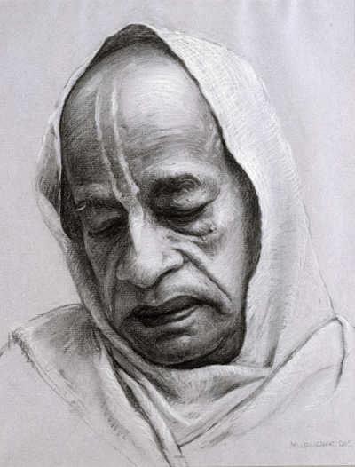
Whatever the case, we must have faith in the word of Krishna. When we purchase a ticket on Pan American or Air India, we have faith that the company will take us to our destination. Faith is created because the company is authorized. Our faith should not be blind; therefore we should accept that which is recognized. Lect. SB Jan. 1974

Slide 30
Aut Authority
To promote the appropriate attitude toward authority, avoiding both a challenging attitude and blind acceptance.
Avoiding fanaticism and speculation/compromise while maintaining thoughtful acceptance of authority to help develop Krishna Consciousness.

Slide 31
One should therefore avoid observing a pure devotee externally, but should try to see the internal features and understand how he is engaged in the transcendental loving service of the Lord. In this way one can avoid seeing the pure devotee from a material point of view. NOD Text 6 Purp.
How do we identify a sadhu? What is a pure devotee? Read NOI mantras 5 & 6

Slide 32
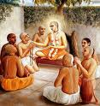
Just try to learn the truth by approaching a spiritual master. Inquire from him submissively and render service unto him. The self-realized souls can impart knowledge unto you because they have seen the truth.

Slide 33
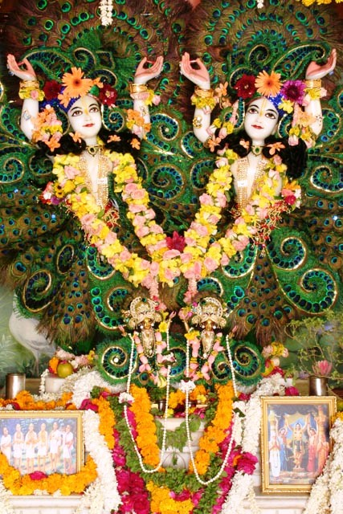

Slide 34
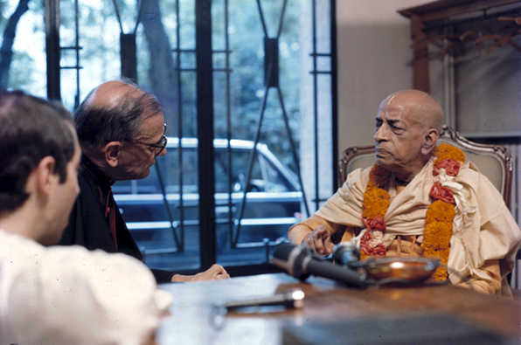
ThA Theological Application
To help create learned Vaishnava theologians who are expert in assisting the Society through application of sastric knowledge to a wide range of personal, social, moral, topical and theological issues.

Slide 35
What are “theological issues?” Can you name some that might need clarification?

Slide 36
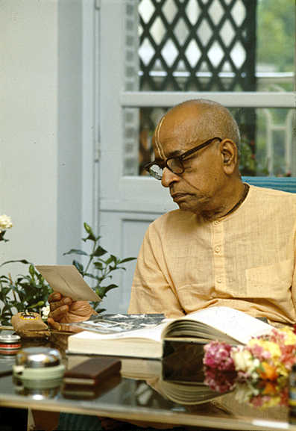
The Bhagavad Gita is spoken by the Lord so that human society can be perfectly
organized from all angles of vision—politically, socially, economically, philosophically and religiously. From any point of view, human society can be reformed by the Krishna Consciousness movement. CC MAD 19. 167

Slide 37
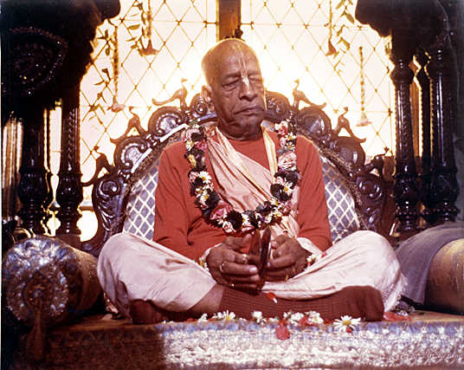

Slide 38
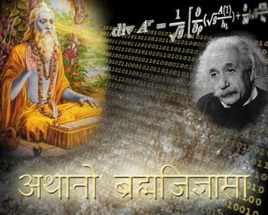
Eva Evaluation
Developing analytical, interpretative and evaluative skills, particularly in respect to the practical application of sastric knowledge.

Slide 39
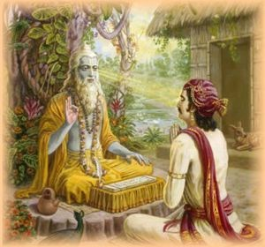
Ability to give advice/counsel etc. that is actually relevant and practically useful to society
Ability to make appropriate choices in personal life

Slide 40
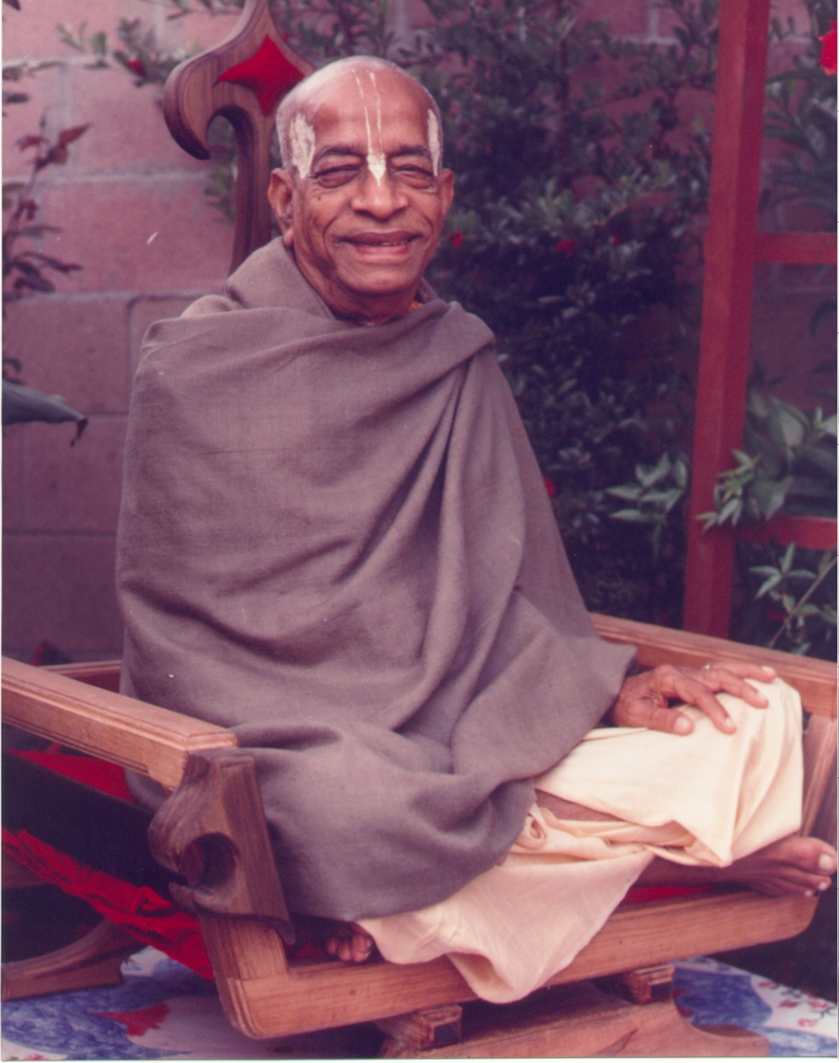
Although Krishna advised Arjuna, “Kill him,” Arjuna did not take it…This is consciousness. Even though there is duty, we have to see what will be the effect of that duty. Nothing should be done blindly. This is the nature of a devotee .Lecture SB 1.7.40

Slide 41
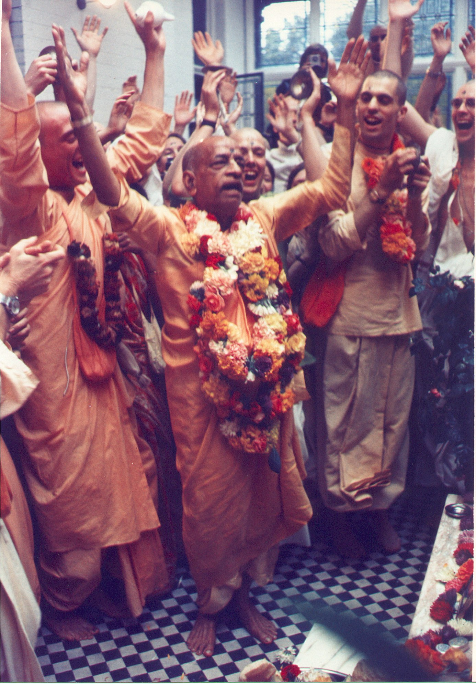

Slide 42
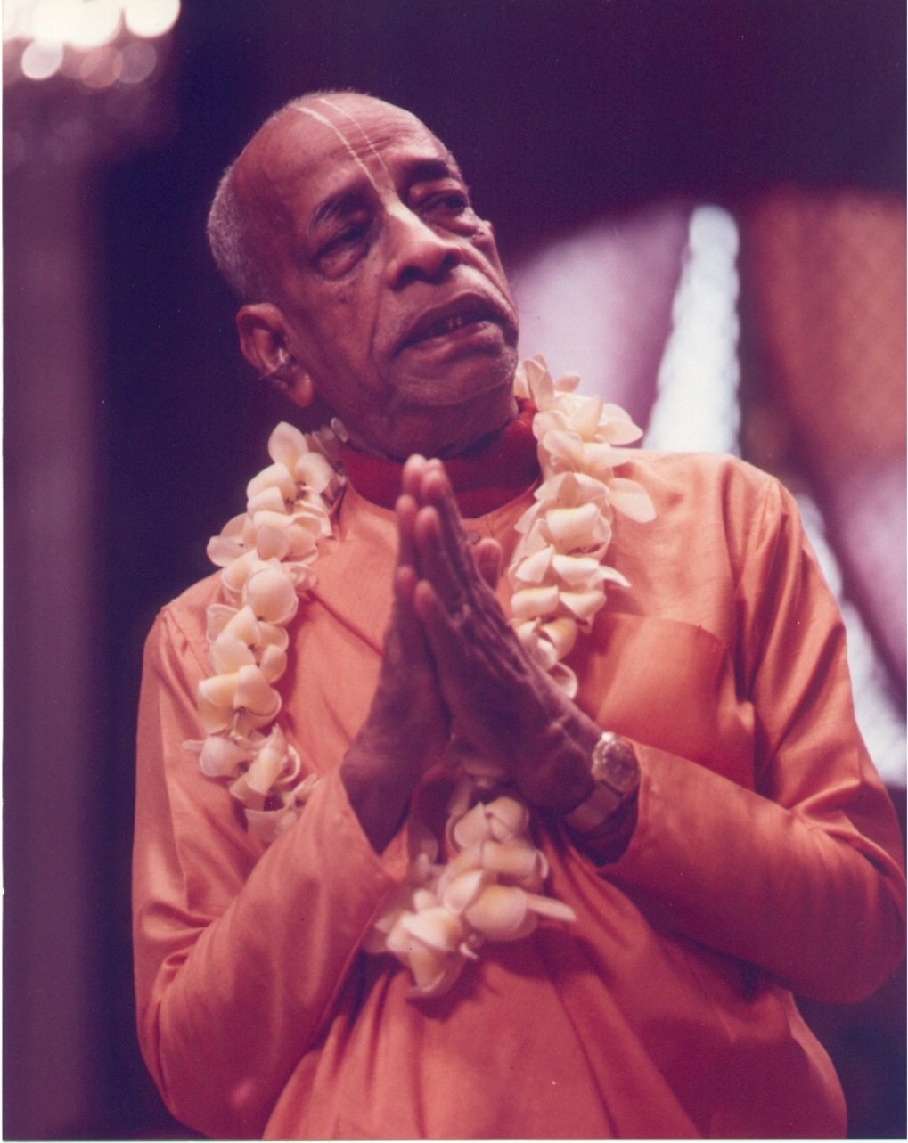
M & M Mood and Mission
Understanding and appreciating the mood and mission of Srila Prabhupada and perpetuating that understanding within the ISKCON Society and its members.

Slide 43
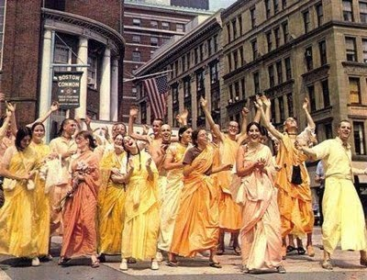
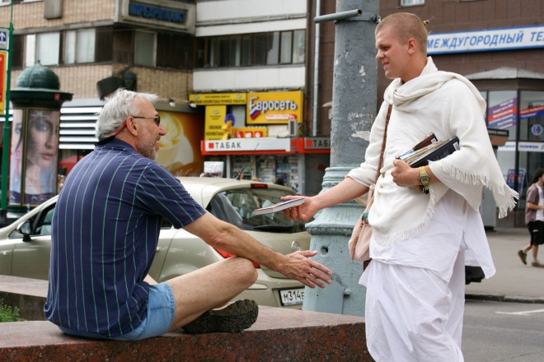
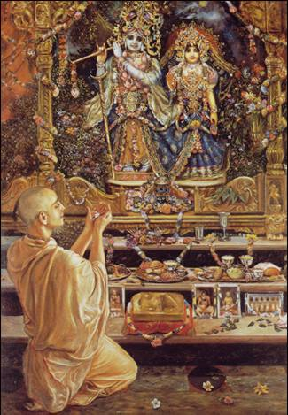
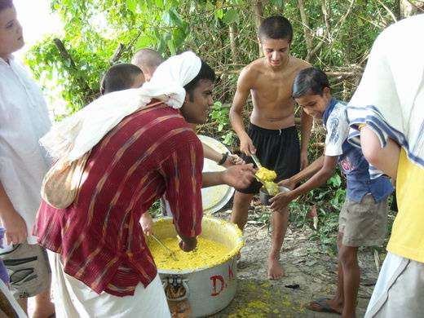
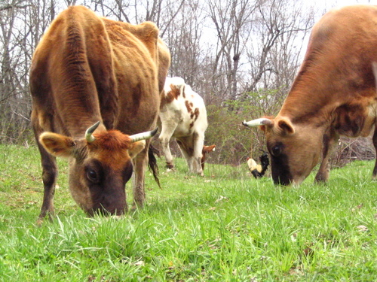
Understanding of Srila Prabhupada’s mood and mission gives you a clear sense of identity and purpose within his society and a balanced sense of one’s place within ISKCON’s overall mission.

Slide 44
Can you:
Explain how a verse or statement relates to and/or reflects Srila Prabhupada’s mood and mission,
Explain how Srila Prabhupada’s translations and purports give insight into his mission and the mission of ISKCON.
Evaluate Srila Prabhupada’s conduct and his attitude towards practice (rules and regulations etc.) in the light of traditional Gaudiya Vaishnava theology.

Slide 45
Identify the main principles upon which Srila Prabhupada’s mission is built and relate these to corresponding scriptural references.
Apply sastra to compare and contrast attitudes and behavior worthy of members of ISKCON and those which are inappropriate.
Identify how Srila Prabhupada’s personal qualities relate to scripture.
Determine the role that Srila Prabhupada’s books play in furthering his mission, and in enriching the lives of his followers.

Slide 46
In conclusion, if a disciple is very
serious to execute the mission of the
spiritual master, he immediately
associates with the supreme
Personality of Godhead by vani or vapu.
This is the only secret of success in
seeing the Supreme Personality
of Godhead. Instead of being eager
to see the Lord in some bush of Vrndaban while at the same time engaging in sense gratification, if one instead sticks to the principle of following the words of the spiritual master, he will see the Supreme Lord without difficulty. SB 4:28:51 purport

Slide 47
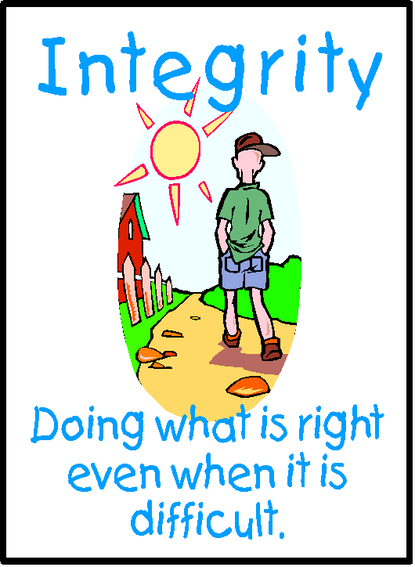
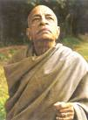
AMI Academic and Moral Integrity
In studying and preaching the scripture it is necessary that we have moral and academic integrity in the interpretation, evaluation and application of sastric knowledge.
.

Slide 48
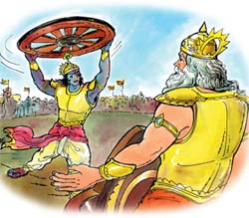
There are two missions: not only to give protection to the devotees, but also to kill the demons. So the devotees of Krishna should be trained up both ways: not only to give protection to the devotees, to give them encouragement, but if need be, they should be prepared to kill the demons. That is Vaishnavism. It is not cowardism. It is not cowardism. When need be…BG1:6-7 lecture
Ways this quote may be misused (2 or 3)
Evaluate the consequences of such misuses.
Select the most likely consequence.
What is Srila Prabhupada’s real point here?

Slide 49
Examples of poor or dishonest use of scripture:
The tendency to quote only half a sloka when the second half modifies or qualifies the first.
Choosing and quoting only verses/evidence that support our own biased opinion and neglecting others.
Citing context relevant materials as absolute truth, or quoting out of context.
Arguing or debating largely or wholly on the basis of emotional appeal,
Quoting a verse that doesn’t actually explain that which we are discussing, or whose meaning is unclear and/or ambiguous.

Slide 50
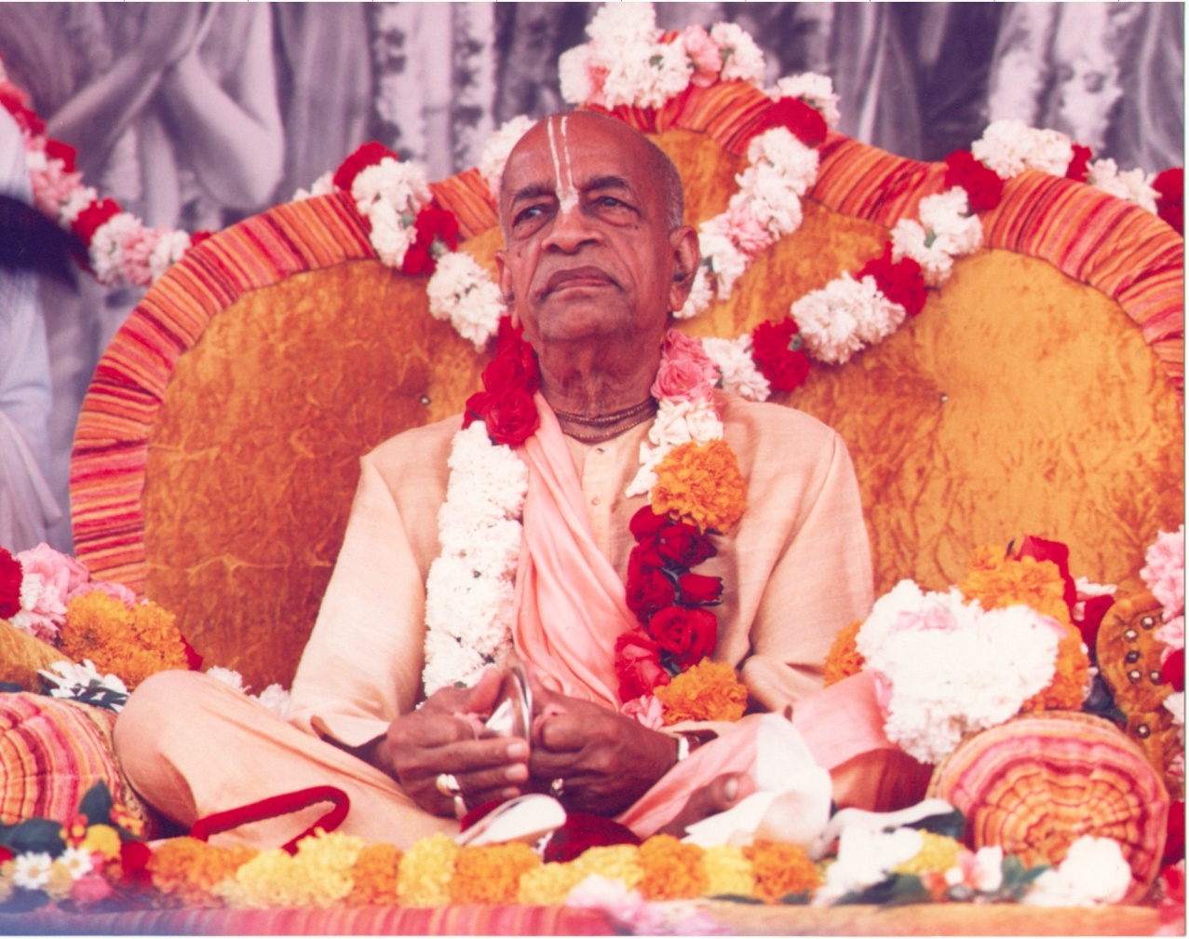
Somebody is misusing the word "so 'ham," "ahaà brahmäsmi" and therefore "I am the Supreme." But that is not. These are Vedic words, but “so 'ham” does not mean "I am God." So 'ham means "I am also the same quality.“ SB 5:25-1

Slide 51
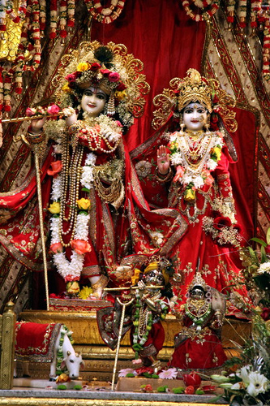

Slide 52
RfL Responsibility for Learning
We must take responsibility for our learning and develop healthy study habits.
Developing a taste and appreciation for the study of Srila Prabhupada’s books and understanding the relevance of sastra within ones’ life will inspire us to study and study well.
Understanding how we learn and what we must do to facilitate our learning will assist us in developing the study skills necessary to learn.

Slide 53
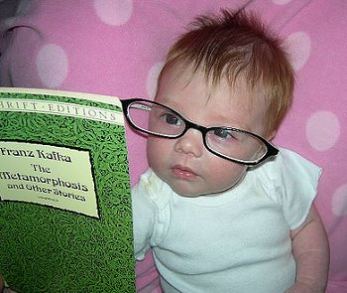
Study Tips?
How to Study Sastra

Slide 54
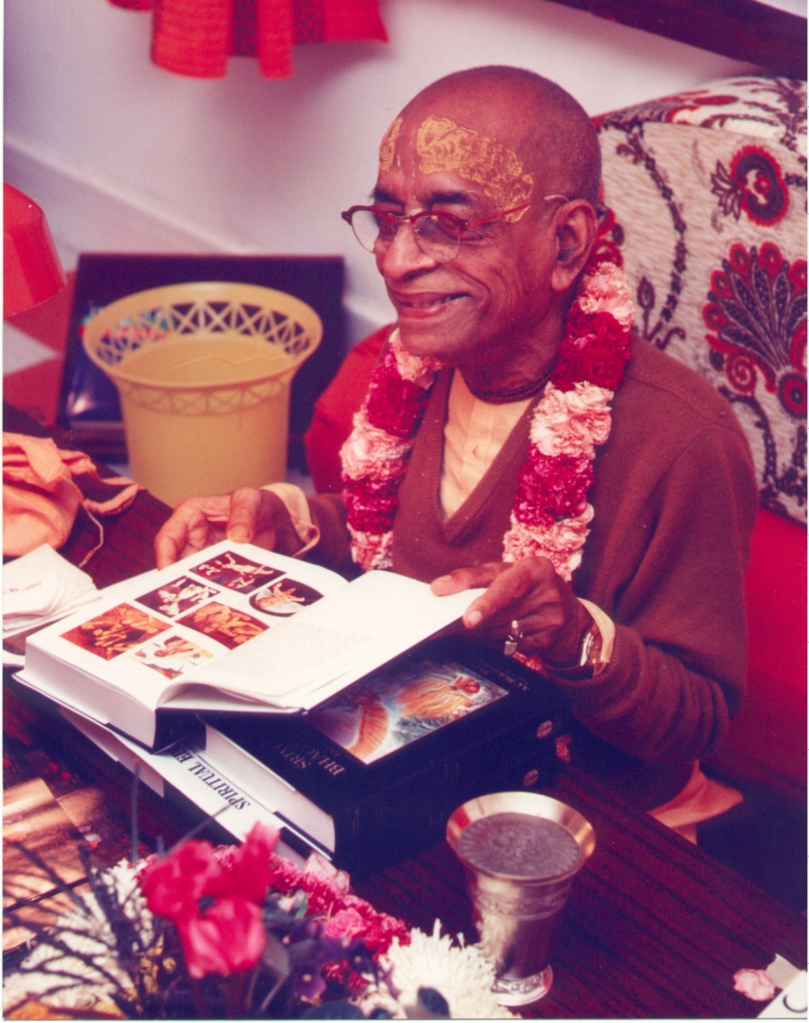
All the devotees connected with this Krishna Consciousness movement
must read all the books that
have been translated
(Caitanya-caritamrta,
Srimad-Bhagavatam,
Bhagavad-gita and others);
otherwise, after some time, they
will simply eat, sleep and
fall down from their position.
Thus they will miss the opportunity to attain an eternal, blissful life of transcendental pleasure CC: Mad. 25: 278

Slide 55
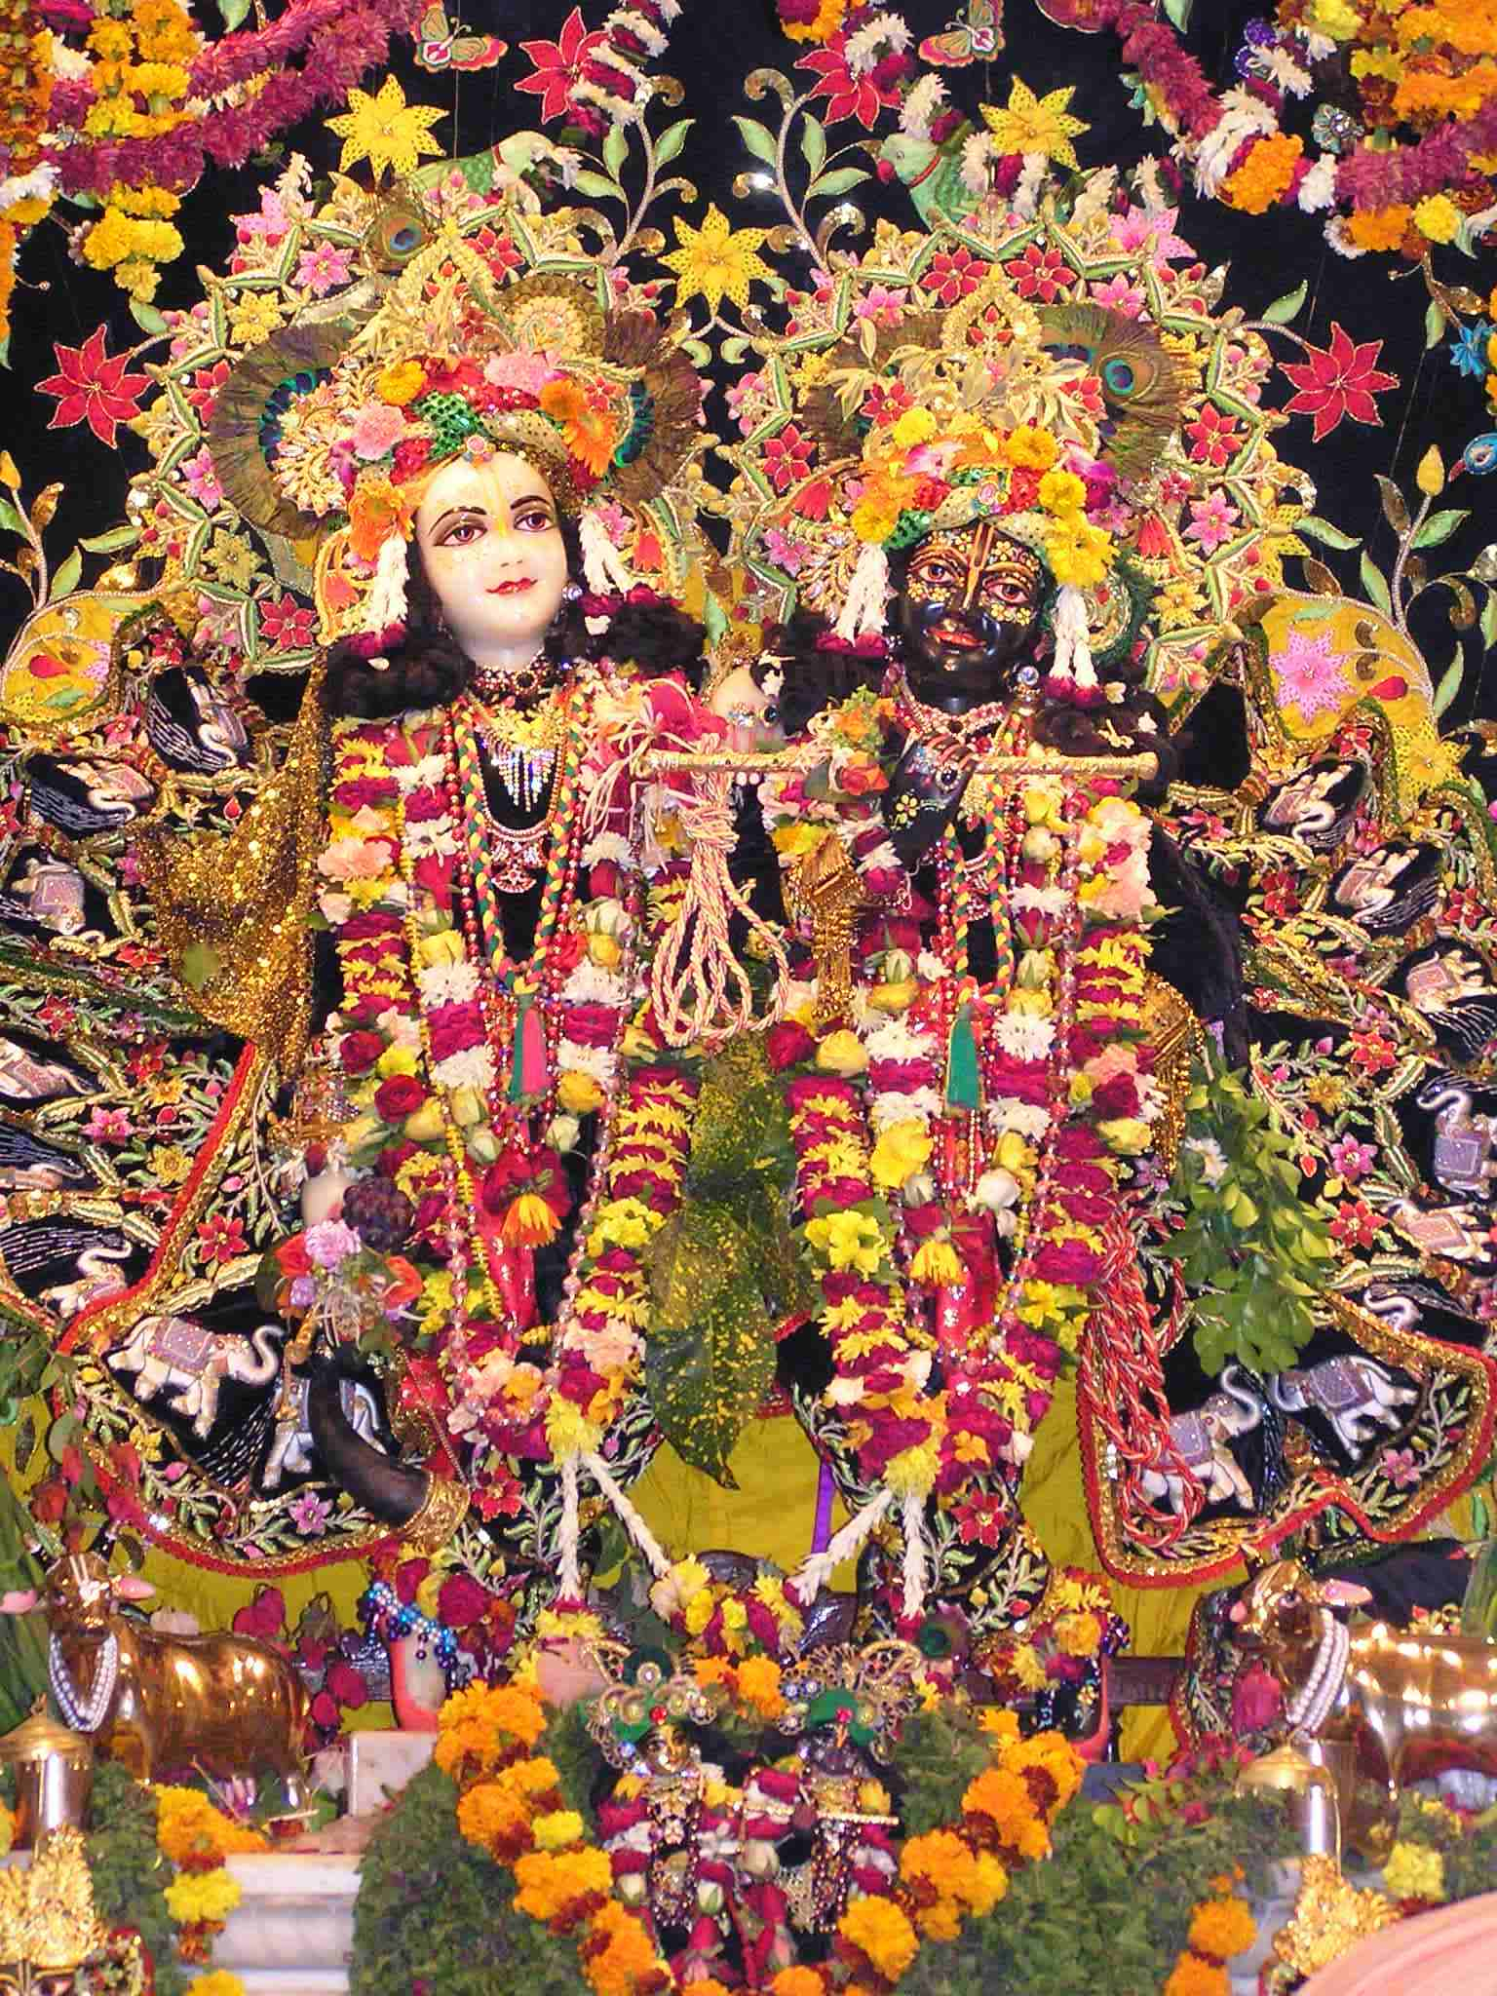

Slide 56
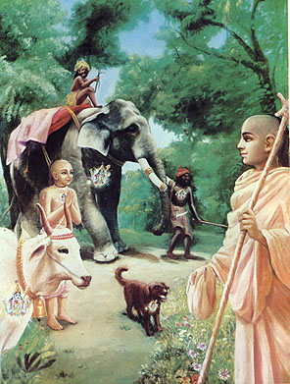
SC Sastra Caksus/ Realization
One should develop the ability to see through the eyes of sastra, with a Krishna Conscious world view. The ultimate goal is to realize Krishna’s presence everywhere and to see His hand in everything.

Slide 57
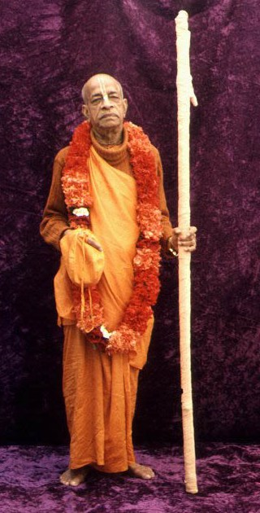
Personal realization does not mean that one should, out of vanity, attempt to show one's own learning by trying to surpass the previous äcärya. He must have full confidence in the previous äcärya, and at the same time he must realize the subject matter so nicely that he can present the matter for the particular circumstances in a suitable manner. The original purpose of the text must be maintained. No obscure meaning should be screwed out of it, yet it should be presented in an interesting manner for the understanding of the audience. This is called realization. SB 1:4:1 purport

Slide 58
Each group should answer the question:
a) What are the results of neglecting this aim?
b) What are the benefits of following this aim?
c) For each aim present a skit, song, etc. illustrating one of their conclusions. Results should refer to real life and not just to a classroom setting.
Students should write the results for each aim on a flip-chart paper to be presented the next day.
Full presentation, including information on the flip charts, comments and questions, should be no more than 15 minutes.

Slide 59
The sphere of outer space constitutes His eyepits, and the eyeball is the sun as the power of seeing. His eyelids are both the day and night, and in the movements of His eyebrows, the Brahmä and similar supreme personalities reside. His palate is the director of water, Varuëa, and the juice or essence of everything is His tongue.
To common sense the description in this verse appears to be somewhat contradictory because sometimes the sun has been described as the eyeball and sometimes as the outer space sphere. But there is no room for common sense in the injunctions of the çästras. We must accept the description of the çästras and concentrate more on the form of the viräö-rüpa than on common sense.
Common sense is always imperfect, whereas the description in the çästras is always perfect and complete.
If there is any incongruity, it is due to our imperfection and not the çästras'. That is the method of approaching Vedic wisdom.

