Slide 1
Coming to the mode of Goodness
Attaining Freedom, Clarity, & Purity

Slide 2
3 modes bind us like rope

Slide 3
Why know about the modes?
The modes affect everything we do:
Perception
Choices
Health
Happiness
Knowledge
Results

Slide 4
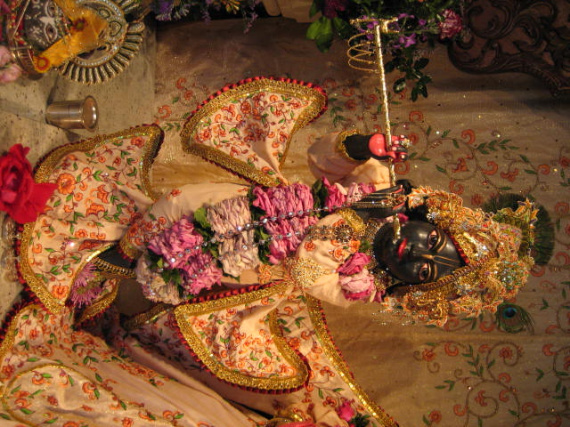
The Law of the World
“There is no being existing, either here or among the demigods in the higher planetary systems, which is freed from these three modes born of material nature.”
Bhagavad-gétä 18.40

Slide 5
Controlled by the modes

Slide 6
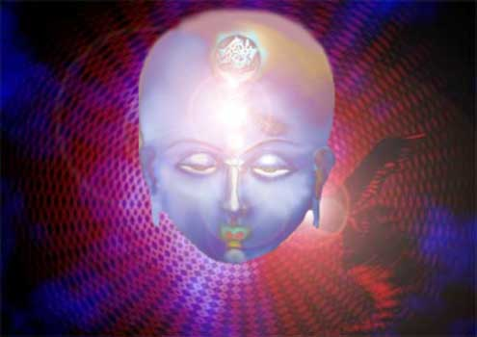
Goodness: Sattva
Karma-yoga, akarma
Senses illuminated by knowledge
Feeling of happiness and knowledge

Slide 7
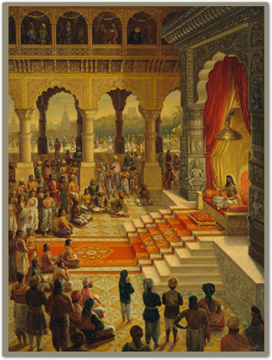
Passion: Rajas
Karma
Unlimited desires and longings
Actions done for personal gain
Great attachment
Intense endeavor
Mixed happiness & suffering

Slide 8
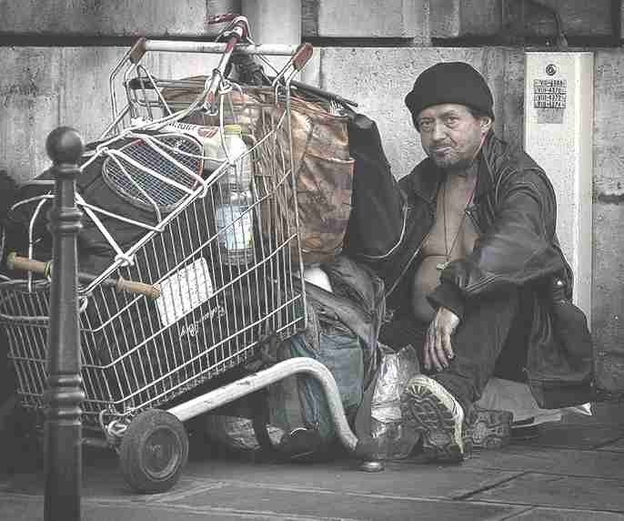
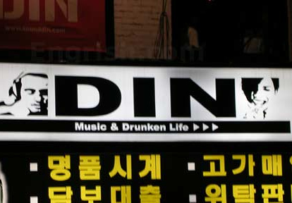
Ignorance: Tamas
Vikarma
Madness, indolence, and sleep
Inertia, illusion
Suffering

Slide 9
Goodness allows us to receive Kåñëa’s grace
Çrémad-Bhägavatam 7.1.9 purport:
“Kåñëa is prepared to give bhakti-yoga to everyone, but one must be capable of receiving it. That is the secret…
“According to one's attitude, Kåñëa becomes one's direct adviser, or Kåñëa becomes unknown. This is not Kåñëa's partiality; it is His response to one's ability to understand Him…..

Slide 10
“Kåñëa is equal to everyone, and according to one's ability to receive the favor of Kåñëa, one advances in Kåñëa consciousness. … the more one advances in sattva-guëa, the more his brilliance is exhibited by devotional service, but the more one is covered by rajo-guëa and tamo-guëa, the less visible his brilliance, for he is covered by these qualities.”

Slide 11
Destination
Goodness:
higher planets or on earth as poet or scientist
Passion:
human body (power, wealth), earthly planet
Ignorance:
lower planets, animal life

Slide 12
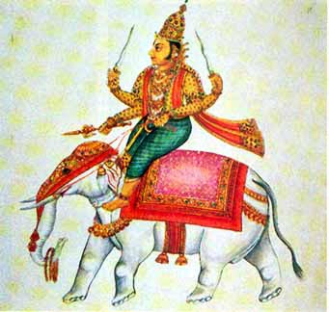
Worship
Goodness: Demigods
Passion: Demons
Ignorance: Ghosts and spirits
In some places, such as Isopanisad, the worship of demigods is described as being in ignorance. Clearly it is not only the object of worship but also the mentality and motive, as there are demons in ignorance who worship demigods.
Many persons in modern society “worship” some political leader, entertainer, and so forth. There are also persons who worship evil spirits and perform demonic rituals to get some powers and wealth. Sometimes they have sexual rituals as part of their “worship.”

Slide 13
Food in goodness
Increase duration of life
Purify one’s existence
Gives strength, health, happiness, and satisfaction
Juicy, wholesome, and pleasing to the heart
Visvanath Cakravarti Thakura: bought with money that was earned purely, cooked purely, and served in a pure place by pure people. Sattva refers to virtue, which brings steadiness of mind enabling one to remain undisturbed in the face of sorrow. Agreeable means to the stomach and the eye, and snigha means having some oil while not excessively fatty.

Slide 14
Food in passion
Too bitter, too sour, salty, hot, pungent, dry
Cause distress, misery, and disease
These are in the mode of passion when taken in excess, as to be healthy one must eat all six ayurvedic tastes—sweet, sour, salty, bitter, pungent (spicy), and astringent. Visvanath Cakravarti Thakura says that “distress” is felt while eating, “misery” after eating, and “disease” is the long-term effect.

Slide 15
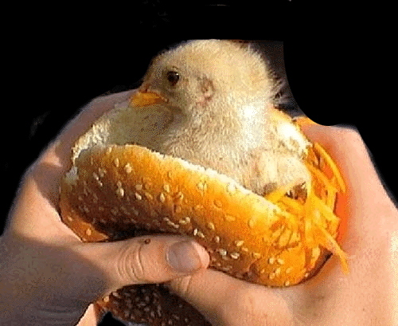
Food in ignorance
Prepared more than three hours before being eaten
Tasteless, decomposed and putrid
Remnants and untouchable things
The ill effects of food in passion affects us in this life, but food in ignorance affects us in both this life and the next.

Slide 16
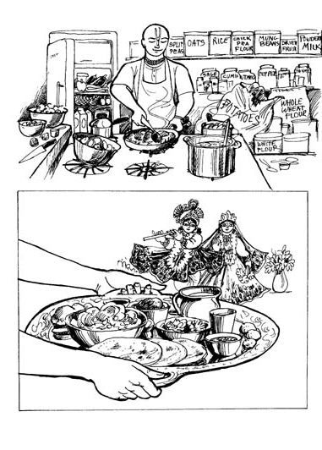
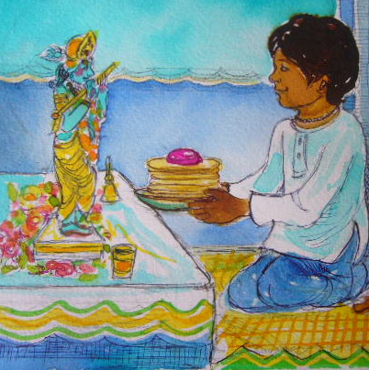
Above the Modes

Slide 17
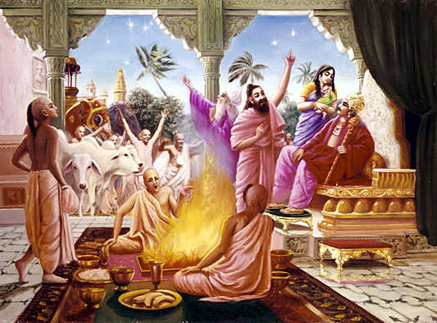
Sacrifice
Goodness:
According to scripture
As a matter of duty
Without desiring reward
Passion:
For some material benefit
For the sake of pride
Ignorance:
Without regard for scriptures
Without distributing sanctified food
Without hymns or remuneration to priests
Without faith

Slide 18
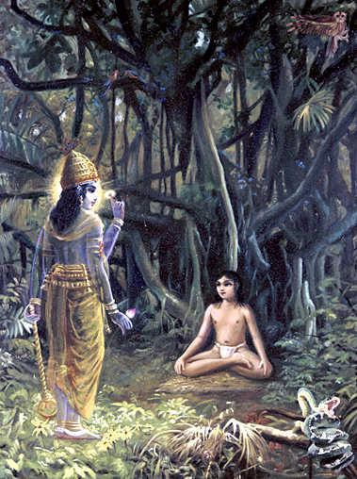
Austerity
Goodness:
Body—worship God and superiors, cleanliness, celibacy, nonviolence
Words—truthfulness, pleasing, beneficial, based on scriptures
Mind—satisfaction, gravity, self-control
Passion:
Out of pride
For respect, honor, and worship
Not stable or permanent
Ignorance:
Out of foolishness
With self-torture or to destroy or injure others

Slide 19
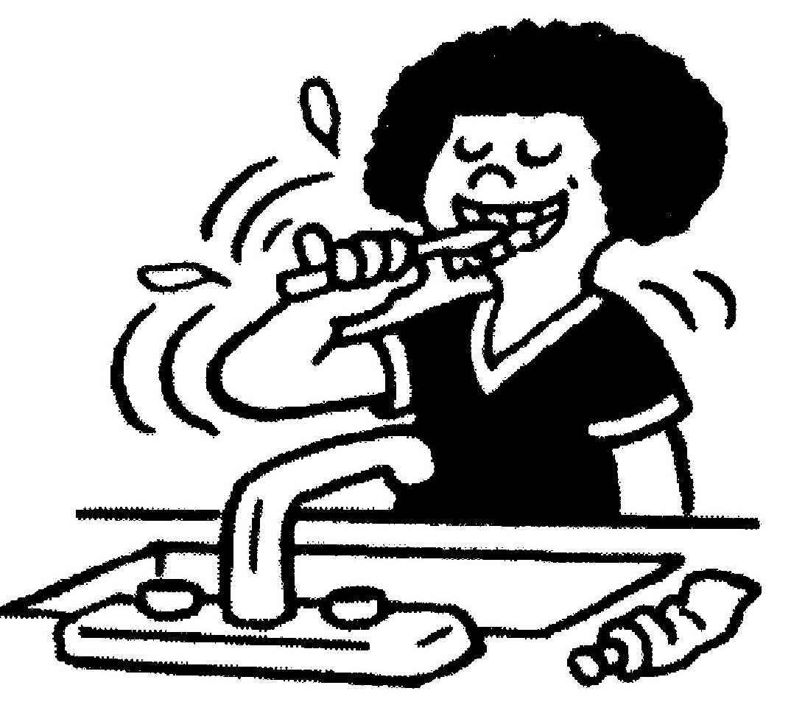
Austerity of the body
a. worship of the Supreme Lord
b. worship of the brahmanas
c. worship of the spiritual master
d. worship of the parents
e. cleanliness
f. simplicity
g. nonviolence
h. celibacy

Slide 20
Austerity of speech
a. speaking words that are truthful
b. speaking words that are pleasing
c. speaking words that are beneficial
d. speaking words that are not agitating to others
e. regularly reciting Vedic literature

Slide 21
Austerity of speech
When speaking (or writing), therefore, we should ask:
Is this true? Can its truth be supported in the scriptures?
Has this person, by their words, social position, or actions, exhibited a sincere willingness to accept the truth I will speak?
Will this truth and the manner in which I’m presenting it actually benefit me and the hearer? Am I presenting it in the most beneficial way possible?
Is my presentation in pleasing language so that it is more likely to be accepted?
“Sharp arrows which pierce one's chest and reach the heart do not cause as much suffering as the arrows of harsh, insulting words that become lodged within the heart when spoken by uncivilized men.” (SB 11.23.3)

Slide 22
Austerity of the mind
a. Satisfaction
b. simplicity
c. gravity
d. self-control
e. purification of one’s existence
Austerity of the mind is to be fixed in Krsna consciousness and always thinking of the welfare of others. This will lead to satisfaction, simplicity, gravity, self-control and purification of existence, which are also austerities of the mind.

Slide 23
Austerity : body, speech, mind
Each of these austerities are progressively more difficult. It is harder to control speech than the body, and harder to control the mind than speech.
The stage of nistha, or brahma-bhuta, is when all three—body, mind, and words, are fully controlled and used only to serve Krishna. In this stage this control is not yet fully spontaneous, but uses determined willpower. Visvanatha Chakravarti Thakura says that generally one will first become fixed in body, then in words, and then in mind, though the order will vary according to an individual’s personal strengths.

Slide 24
Charity
Goodness:
Given out of duty
Without expectation of return
Proper time and place and to a worthy person
Passion:
With expectation of return or desire for fruitive results
In a grudging mood
With regret later
Out of obligation
Ignorance:
At an impure place, improper time, and to unworthy persons
Without proper attention and respect

Slide 25
Sattvic charity… Hands help from a happy heart

Slide 26
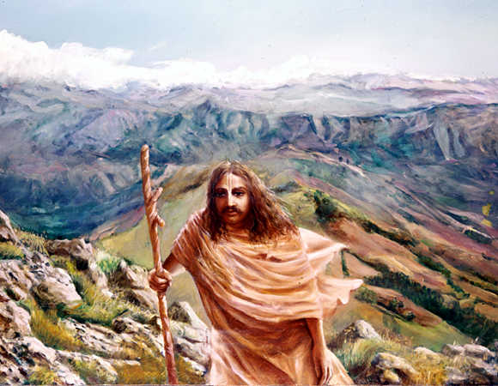
Renunciation
Goodness:
Duty done because it ought to be done
Giving up material association and attachment to the fruits of one’s work
Passion:
Giving up work because it is troublesome or out of fear of bodily discomfort
Does not lead to elevation
Ignorance:
Giving up prescribed duties
Whimsical

Slide 27
Understanding
Goodness:
Knows what is to be done and is not to be done
What is to be feared and what is not to be feared
What is binding and what is liberating
Passion:
Cannot distinguish between religion and irreligion
Cannot tell what should be done and what should not be done
Ignorance:
Considers religion to be irreligion and irreligion to be religion
Under the spell of illusion and darkness
Strives in the wrong direction

Slide 28
Knowledge
Goodness:
One spiritual nature seen in all bodily forms
Passion:
Each type of body has a different type of living being
Ignorance:
Attached to one kind of work as everything
Without knowledge of truth
Very meager

Slide 29
Knowledge in goodness

Slide 30
Action
Goodness:
Regulated
Without attachment, love or hatred
Passion:
With great effort by one seeking to gratify his senses
Ignorance:
Done in illusion
Disregard for scriptural injunctions
Without concern for future bondage or violence and distress to others

Slide 31
Duty
Goodness:
Without false ego
Great determination and enthusiasm
Without wavering in success or failure
Passion:
Attached to work and fruits of work
Greedy and envious
Moved by sorrow and joy
Ignorance:
Against scriptural injunctions
Materialistic
Obstinate
Cheating
Expert in insulting others
Lazy, morose, and procrastinating

Slide 32
Determination
Goodness:
Unbreakable
Sustained with steadfastness by yoga practice
Controls the mind, life, and senses
Passion:
Holds to fruitive results in religion, economic development, and sense pleasure
Ignorance:
Cannot go beyond dreaming, fearfulness, lamentation, moroseness and illusion

Slide 33
Happiness
Goodness:
Poison in the beginning and nectar at the end
Awakens one to self-realization
Passion:
Comes from contact of the senses with their objects
Nectar in the beginning and poison at the end
Ignorance:
Blind to self-realization
Delusion from beginning to end
Arises from sleep, laziness and illusion

Slide 34
Happiness
Happiness in goodness is inner, mental peace and satisfaction, though the process of purification to get there requires restraint and austerity.
Happiness in goodness may appear to be poison but happiness in passion truly is poison as it increases our material desires and forces us back into rebirth. This happiness requires no restraint and brings some immediate sensation of pleasure which quickly turns to distress.
In ignorance one may simply think about unattainable happiness. Any deliberate self-forgetfulness such as intoxication, wishing one were dead, oversleeping, etc. is a form of ignorance. There is not even a mental conception of happiness in this mode.

Slide 35
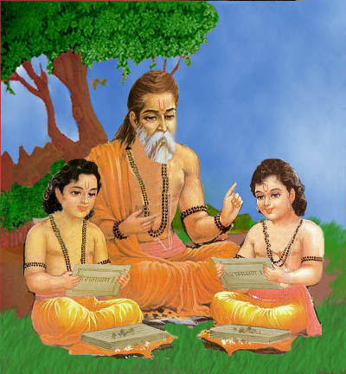
Qualities
1. peaceful
2. self-controlled
3. austere
4. pure
5. tolerant
6. honest
7. knowledgeable
8. wise
9. religious

Slide 36
Becoming steady in bhakti
Sivarama Swami:
Before devotees attain steadiness, the presence of abundant unwanted habits makes them lightning rods for the modes of passion and ignorance. Awake or asleep, such devotees are easy targets. When passion predominates, they feel sexually disturbed and therefore humiliated. When goodness defeats passion they find themselves hoping for imminent deliverance from material life. But when ignorance defeats goodness and passion, such devotees despair. Until most of their bad habits leave the heart, devotees are unable to become steady in their spiritual no matter how hard they try. This summarizes the relatively unfulfilling state of unsteady devotional service.

Slide 37
But as unwanted habits leave the heart, passion and ignorance decrease proportionately and the mode of goodness becomes increasingly dominant. The five obstacles — sleep, distraction, indifference, the inclination to sin, and thirst for sense enjoyment — dwindle to insignificance, and devotees finally achieve steadiness. Unlike the lower modes, goodness is conducive to spiritual life. In a spiritually enlivened state, devotees then become happy.

Slide 38
“As soon as irrevocable loving service is established in the heart, the effects of nature’s modes of passion and ignorance, such as lust, desire, and hankering, disappear from the heart. Then the devotee is established in goodness, and he becomes completely happy.”
Çrémad-Bhägavatam 1.2.19

Slide 39
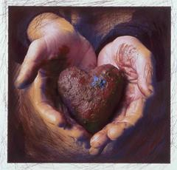
To come to goodness
We must rid our hearts of unwanted, dirty things

Slide 40
Illusion
Identity as body and mind
God as only impersonal
Material world as pleasurable
Religious rituals as the process of spiritual perfection

Slide 41
Weakness of heart
Wanting to dominate material nature
Possesiveness
Desire for fame
Envy
Deceit or fault finding
Attachment to things unrelated to Krishna

Slide 42
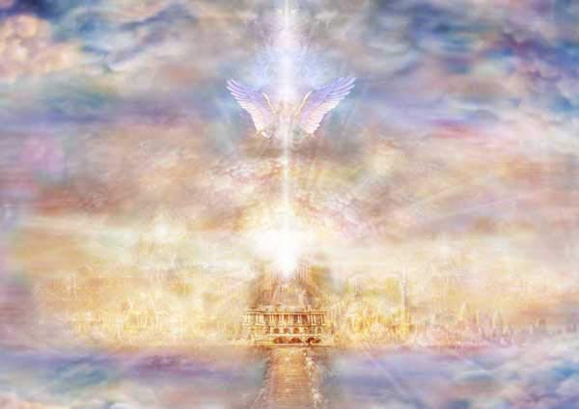
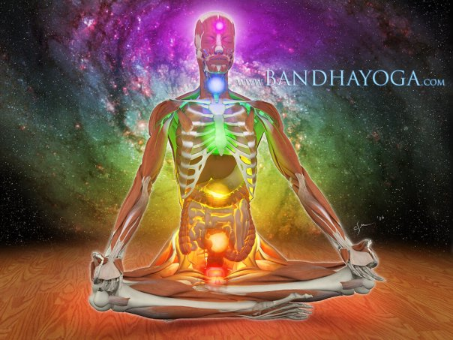
Material desires for
Objects
Heavenly comforts
Mystic powers
Salvation

Slide 43
Enemies
Lust
Anger
Greed
Illusion
Pride
Envy

Slide 44
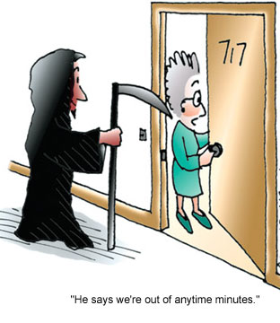
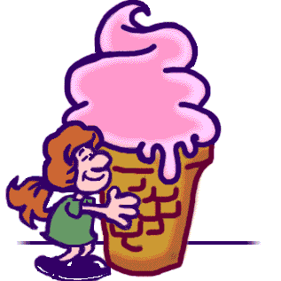
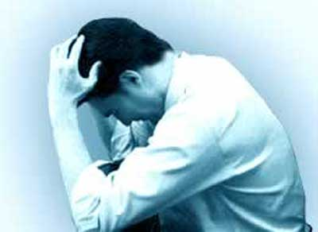
Waves
Distress
Illusion
Hunger
Thirst
Old age
Death

Slide 45
Process
Good association
Sadhus
God
Form
Name
Scriptures
Holy Places
Following the process of bhakti
Making choices according to guru and scripture

